Slide 1

NCEA (NATIONAL CERTIFICATE OF
EDUCATIONAL ACHIEVEMENT)

Slide 2
How NCEA Works
The National Certificate of Educational Achievement (NCEA) is the main qualification for secondary school students in New Zealand.
NCEA is recognised by employers, and used for selection by universities and polytechnics, both here in New Zealand and overseas.
The qualification is managed by NZQA (New Zealand Qualifications Authority)

Slide 3
YEAR 10 &11
We don’t complete NCEA Level 1
Some Year 11 courses offer a few Level 2 NCEA credits
Year 10 students sit the digital literacy & numeracy exams. These are needed for NCEA Level 2 and Level 3

Slide 4
YEAR 12
NCEA Level 2
Students require:
60 Level 2 (or 3) credits
10 numeracy and 10 literacy credits

Slide 5
YEAR 13
NCEA Level 3
Students require:
60 Level 3 credits
10 numeracy and 10 literacy credits

Slide 6
Achievement Standards (topics) & Grades
Internal and External Assessments
Excellence
Merit
Achieved
Not Achieved

Slide 7
Unit Standards (topics) & Grades
Internally Assessed Only
Achieved
Not Achieved

Slide 8
NCEA – Assessments
Internal Assessments – are tests or assignments set and marked by class teachers during the year.
External Assessments – are the end of year exams or portfolios.

Slide 9
Internal Assessments
Tests – done in class time
Assignments - done in student’s own time
and at school
In general, handed in by 4 pm

Slide 10
Internal Assessments
These are run under NCEA conditions (refer to the Assessment Procedures Student Handbook)
Students receive written confirmation of due date or test date at least 2 weeks in advance from their subject teacher
Students know about task requirements
Students can appeal a result (with valid grounds, see Tutor)
Students sign to accept results and accuracy of grades recorded for them

Slide 11
Aiming High – Certificate Endorsements - NCEA Level 2 & 3 – can be obtained across more than one year
Certificate Endorsement with Excellence
  50 credits at Excellence.
The student will also gain Lincoln High School Academic Colours.
Certificate Endorsement with Merit
  50 credits at Merit (or Merit and Excellence). The student will also gain a Lincoln High School Academic Achievement Award.
In 2022, 42 % of Lincoln High School Year 12 achieved an Endorsement; it
is not something that only the ‘top’ get!

Slide 12
Aiming High – Course Endorsement – NCEA Level 2 & 3 - obtained within the current year
Course Endorsement with Excellence
14 credits at Excellence, with at least 3 credits from internal and
external assessments.
Course Endorsement with Merit
14 credits at Merit, or Merit and Excellence, with at least 3 credits from internal and external assessments.

Slide 13
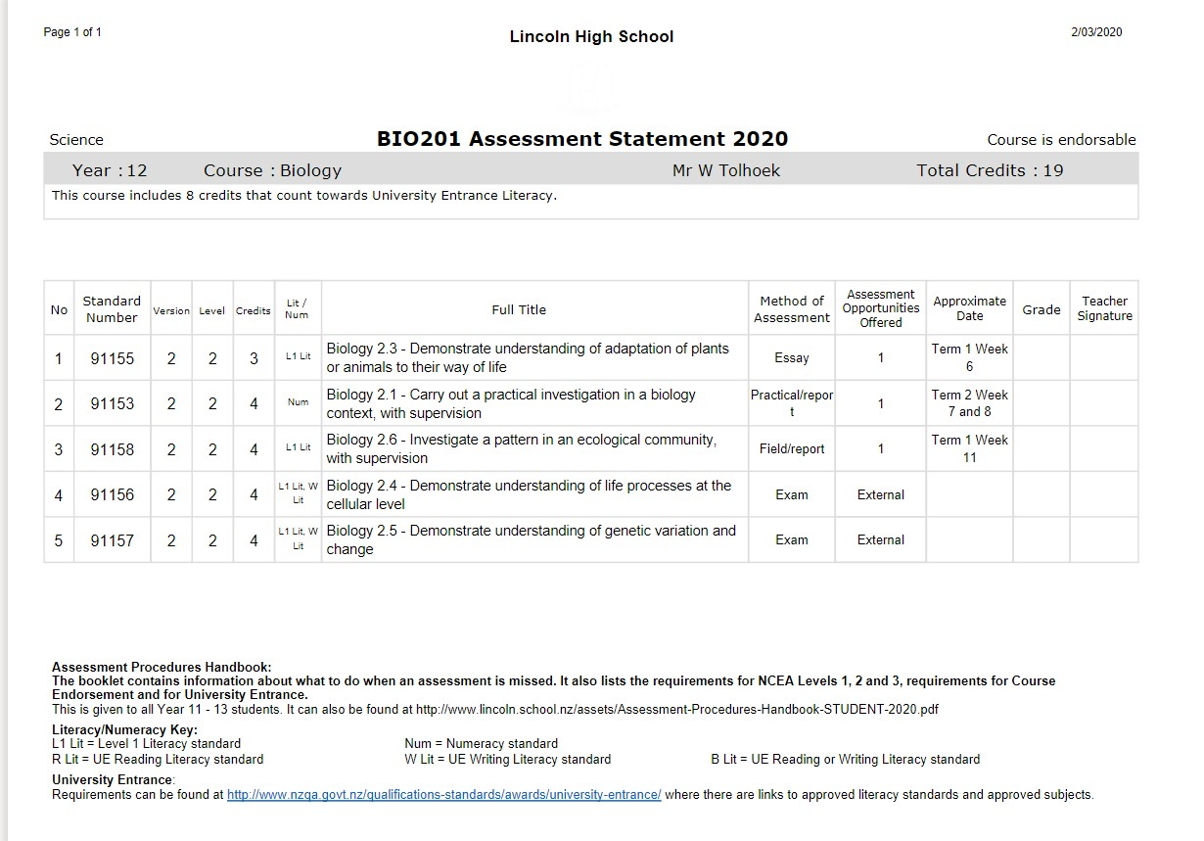
Assessment Statements – see Kamar portal under Results
These are critical, so students and families can track a student’s
progress

Slide 14
Missed Assessments (Internals – during the year)
To get a catch up opportunity (sit the test) or get an extension of time for an assignment students must:
  Message on Teams the Tutor if they are unwell. They may be asked to gain a medical certificate, provide some brief details regarding illness, subject, teacher and assessment.
  If they have a sports tournament etc message on Teams the Tutor giving dates and the assessment, teacher and subject in advance of the tournament.
They will not be eligible for an extension/resit for family holidays.

Slide 15
External Assessment – end of year
External Assessments are usually exams sat in November. Every student in New Zealand sits these at the same time. At Lincoln High School this is for NCEA Level 2 and 3
External Examination Timetable is available on the NZQA website
https://www.nzqa.govt.nz/assets/qualifications-and-standards/qualifications/ncea/exams-and-portfolios/2023-exam-timetable.pdf

Slide 16

How you could support your student?
Monitor progress using Assessment Statements (Kamar portal) and record results
Access results from the Kamar portal
Access the NZQA website to access past exam papers and answers
If your student is concerned encourage them to talk to their teacher
Encourage your student to attend tutorials and/or the Homework group on Thursdays after school
Attend parent interviews/ Linc teacher conference with student
Display and monitor study plans during exams
Encourage your student to access NCEA related websites (No Brain too Small, Learn Coach etc)

Slide 17
Entry to Level 2 & 3 courses
Many courses have entry recommendations. These outline the level of learning/knowledge a student should have so that they will cope in a course. Entry requirements are specified in the online course information www.lincoln.school.nz/courses
Some courses are open entry

Slide 18
University Entrance (UE) – the minimum requirement to gain entry to most university degrees
NCEA Level 3
&
14 credits in at least three approved University Entrance subjects (see Level 3 course details to see if a course is UE approved)
&
UE literacy -10 Literacy credits at NCEA Level 2 or 3 made up of at least 5 in reading and 5 in writing
&
Numeracy - 10 credits

Slide 19
Further information
NZQA Information page
http://www.nzqa.govt.nz/ncea/understanding-ncea/how- ncea-works

Slide 20
Year Level Tutors
Encourage your student to come and see their Tutor –
Careers Hub. Message them on Teams
If you have any questions email:
Year 11 | Diane Walker | dwa@lincoln.school.nz
Year 12 | Susan Johnson | sjn@lincoln.school.nz
Year 13 | Bronwyn Gardiner | bga@lincoln.school.nz

