Slide 1
NCEA Literacy and Numeracy Simply Explained (https://ncea.education.govt.nz/)

Slide 2
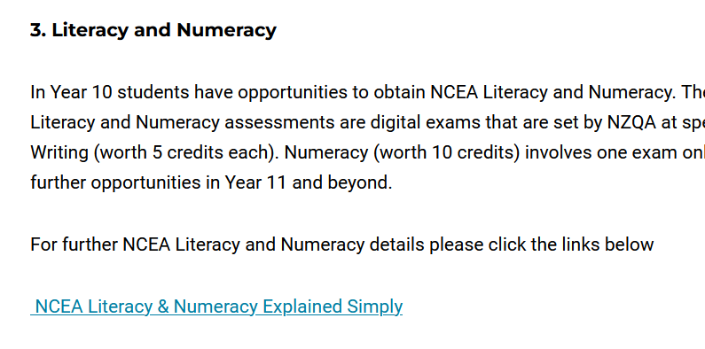
This presentation is on our website
The presentation

Slide 3
Acronyms
NCEA – National Certificate of Educational Achievement
MOE – Ministry of Education
NZQA – New Zealand Qualifications Authority
LHS – Lincoln High School

Slide 4
NCEA Changes as of 2024
Strengthening NCEA by making a series of changes to improve well-being, equity, coherence, pathways and credibility. Changes led by the MOE and implemented by NZQA who administer NCEA.
Make NCEA more accessible
Equal status for mātauranga Māori in NCEA
Strengthen literacy and numeracy requirements & assessments
Fewer, larger standards
Simplify NCEA's structure
Clearer pathways to further education or work
Keep NCEA Level 1 optional

Slide 5
Implementation
The new NCEA Level 1 will be fully implemented nationally in 2024 Level 2 will be implemented in 2026 and Level 3 in 2027 – note: LHS does do Level 1 NCEA
From 2024 the Literacy and Numeracy standards will become a mandatory corequisite to the NCEA qualification.

Slide 6
Implementation - cont’d.
i.e. to gain NCEA Level 1, 2 or 3 you need to have also gained literacy and numeracy.

Slide 7
The Literacy and Numeracy Standards (topics)
1) Numeracy – US 32406: Use mathematics and statistics to meet the numeracy demands of a range of situations (10 credits)
2) Literacy:
Reading - US32403: Read written texts to understand ideas & information (5 credits)
Writing - US32405: Write texts to communicate ideas and information (5 credits)

Slide 8
Digital Exams – dates determined by NZQA
Students will be enrolled in the digital exams once it is confirmed they are “at the level”, following “readiness” school assessments.
Year Level | Literacy (Reading) | Numeracy | Literacy (Writing)
Year 10 | All classes: Week of 16th September | Semester 1 Maths classes: Week of 27th May Semester 2 Maths classes: Week of 16th September
Year 11 |  |  | 2025: Dates TBC

Slide 9
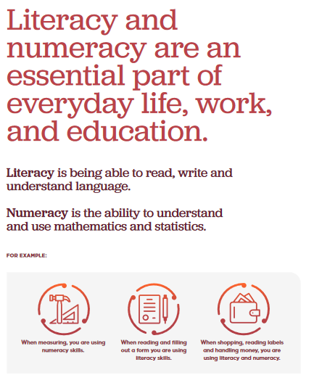
What is Numeracy and Literacy?

Slide 10
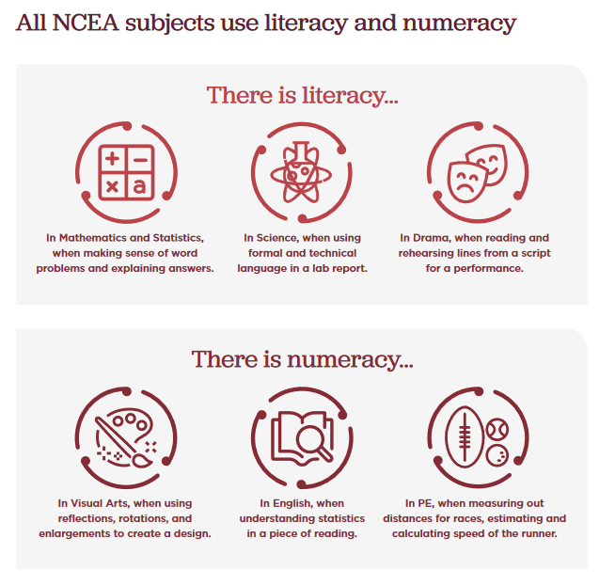
What is Numeracy and Literacy? – cont’d.
Literacy & numeracy are not limited to English and Maths. They apply to all courses at school and are an essential part of everyday life.

Slide 11
Numeracy - “real world” scenarios involving:
Operations on number
Mathematical relationships
Spatial properties and representations (of shapes)
Location and navigation
Measurement
Statistics and data
Elements of chance (probability)

Slide 12
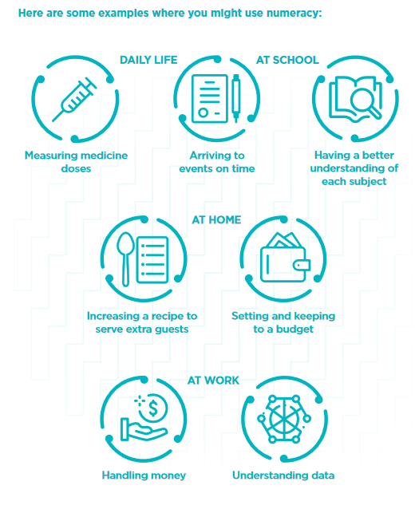
Examples of Numeracy

Slide 13
What is NCEA Literacy?
Having literacy is about being able to read, write and speak effectively to communicate ideas and knowledge.
Reading – understand ideas and information in written texts in books or articles, textbooks with language and pictures, texts and images on websites, messages in social media, and so on.
Writing – write texts to communicate information and ideas , using language in a way that the audience can understand, and that suits the purpose of the text you want to write.

Slide 14
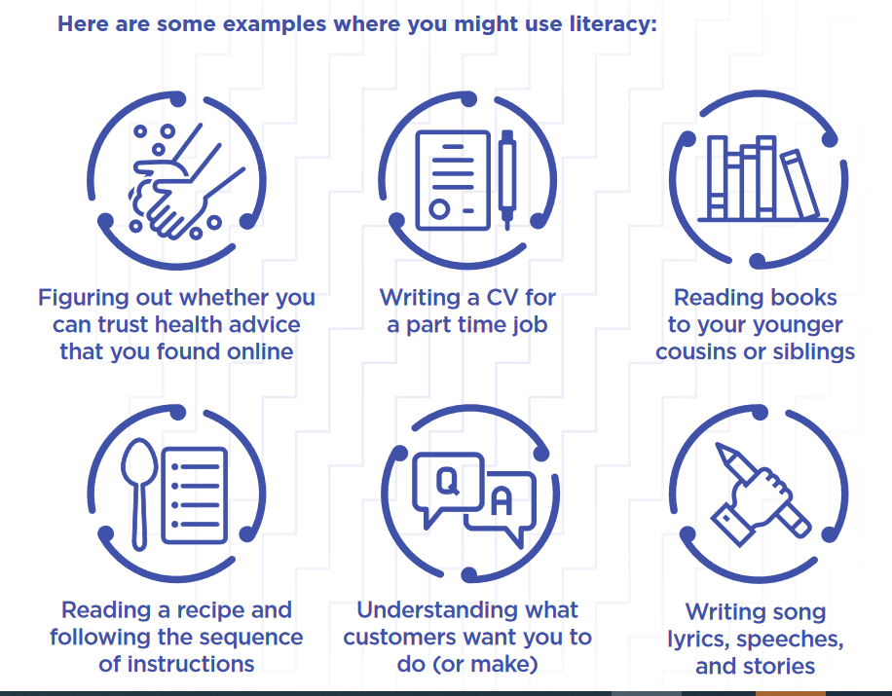
Examples of Literacy

Slide 15
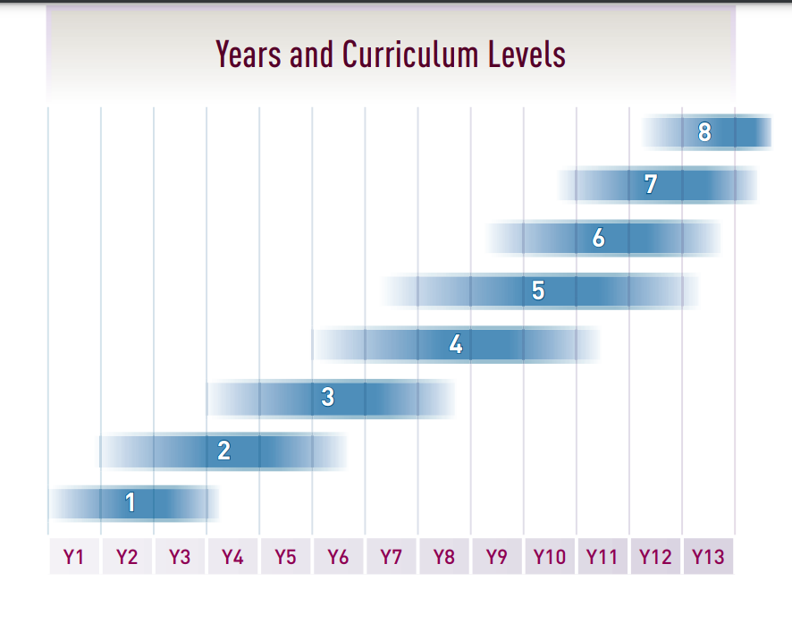
We are preparing our Yr 10 students for the literacy & numeracy assessments
Literacy standards = upper level 4 & lower level 5 of the English NZ Curriculum
Numeracy standard = upper level 4 and lower level 5 of the Mathematics and Statistics NZ Curriculum.

Slide 16
How Can Students Prepare for the Digital Exams?
Numeracy:
Maths courses
Microsoft Teams tasks, including starters in class
NZQA past digital exams
2) Literacy:
English courses
Literacy starters at the beginning of each day in all classes
NZQA past digital exams
3) General:
Familiarise yourself with the digital exam platform (see slide 23)
Note: If a student does not achieve the Numeracy, Literacy standards, then they can redo the digital exam in Year 11 onwards until they do pass these assessments.

Slide 17
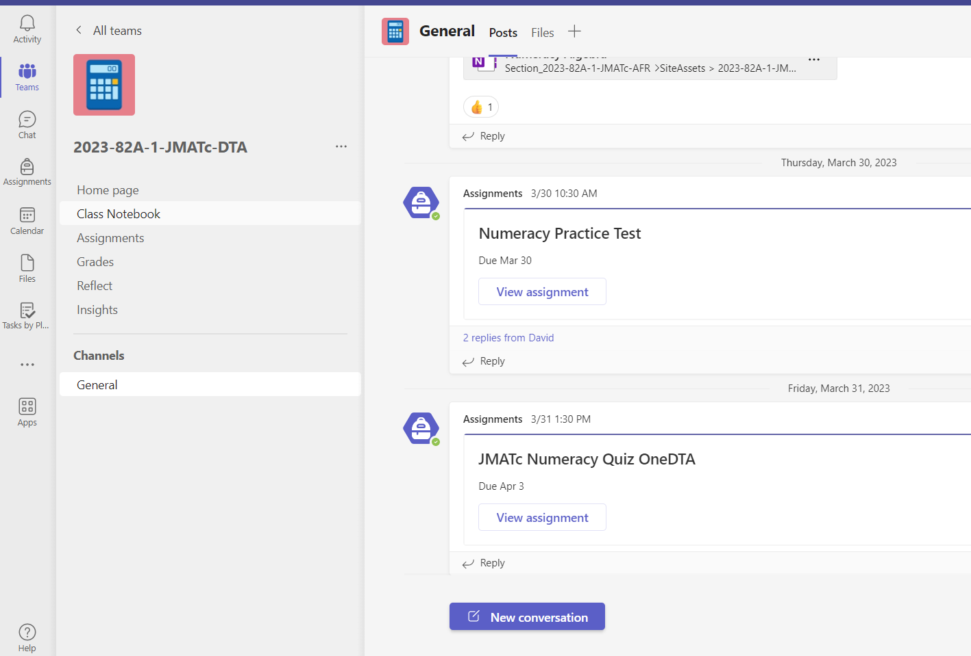
Numeracy work – Microsoft Teams – Year 10
In class Teams, either in:
Files
Assignments
Posts

Slide 18
How can parents support their student with Numeracy?
Ask your student to show you what they are working on, especially in Microsoft Teams. Get them to check for any related notes
Do “real world Maths” with them in your daily life: e.g.
Estimating and then measuring things
Reading timetables and charts
What time should we leave to get there by….?
Am I better buying 4 x 2.25L of coke or 6 x 1. 5 L?
How much would 3 packets of … cost me?
What’s the discounted price with 20% off this?
(and make sure they round money to the nearest 1 cent )

Slide 19
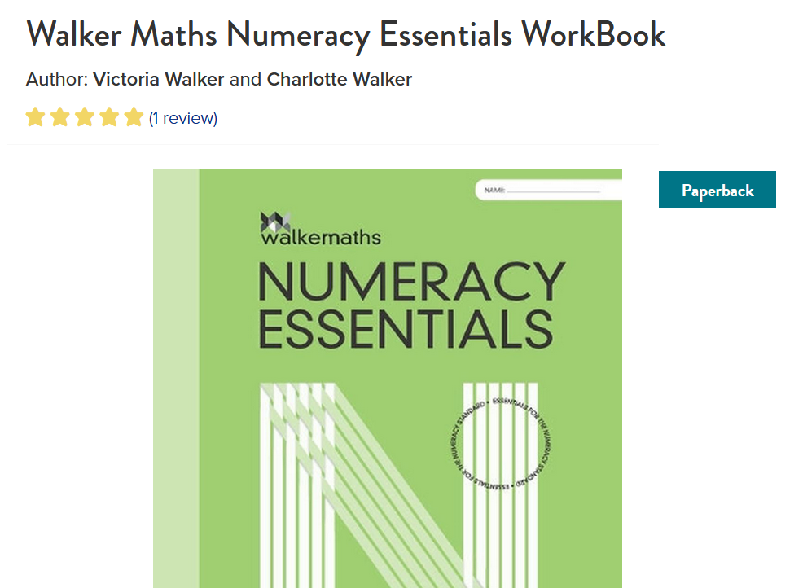
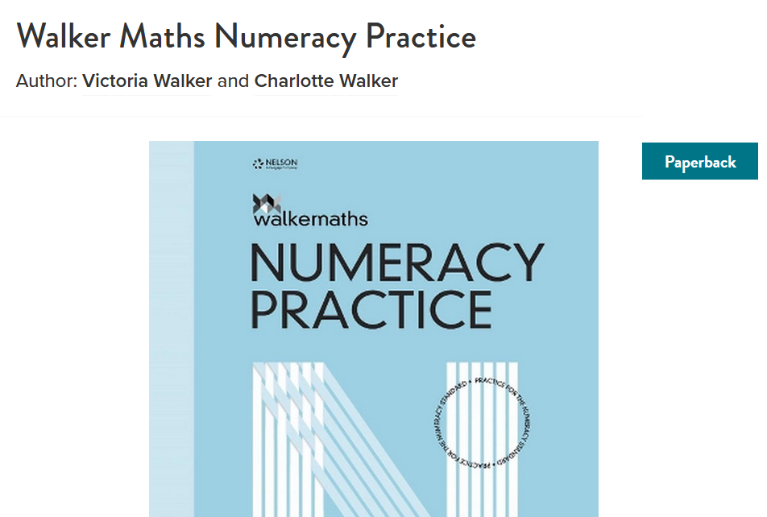
How can parents support their student with Numeracy?
6. Consider purchasing supporting textbooks
7. Go through past exams and answers with your student (see slide 22).

Slide 20
How can parents support their student with Literacy?
Proofread student’s work e.g. ask your student to write an email and a letter, using a formal tone, and proofread it. Check spelling and grammar including full stops and sentences starting with capital letters.
Get students to practice writing a formal letter e.g. a covering letter for a part-time job application.
If a student comes across an unfamiliar word, ask them what it could mean by looking at the context of the writing i.e. use the context to work out the meaning, instead of telling them the meaning.
Remember, literacy includes reading and writing so we want to support our students with both.
Point out appropriate wording for a written piece e.g. the wording for social media messaging is not appropriate for a letter, or how words can influence a reader.

Slide 21
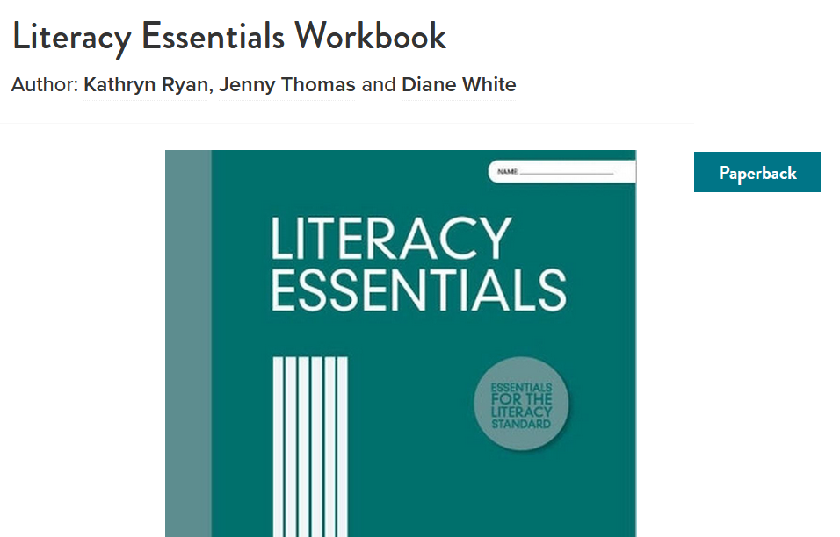
How can parents support their student with Literacy?
6. Consider purchasing a supporting textbook
7. Go through past exams and answers with your student (see slide 22).

Slide 22
The Digital Exams
Approximately 60 minutes long
Students work on their own device (not phones)
Exams occur in classrooms
Exam conditions apply
Reader/writer support provided for those eligible
Physical and digital supervisors
The whole country sits the same exams during the same exam period
Results (Achieved or Not Achieved) released approximately 8 weeks later by NZQA
Results will be imported into Kamar. Available of the Kamar portal

Slide 23
Familiarise yourself with the digital exam platform
https://www2.nzqa.govt.nz/ncea/external-assessment/about-digital-external-assessment/preparation-for-students/
Check that your device is suitable for the digital exams
Watch the video that explores the digital platform
Run through/ hands-on introduction to the digital exams
Note: You can only access the digital platform using the Chrome browser.

Slide 24
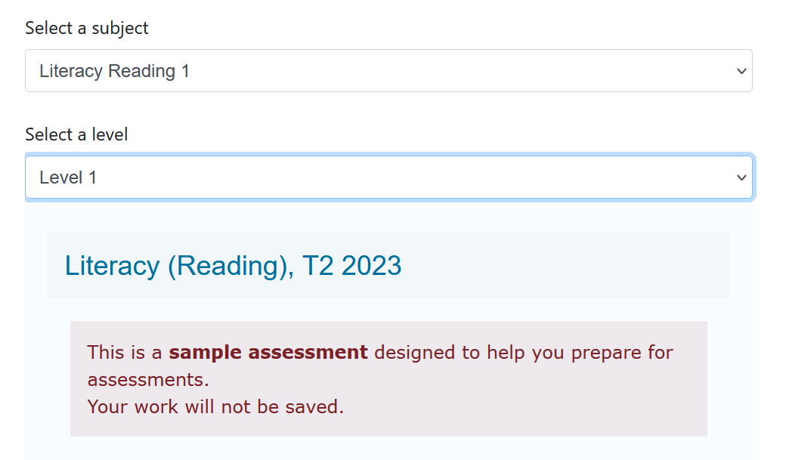
Access Past Digital Exams on the NZQA website
https://www.nzqa.govt.nz/ncea/ncea-exams-and-portfolios/external/digital-exams/find-past-digital-exams/

Slide 25
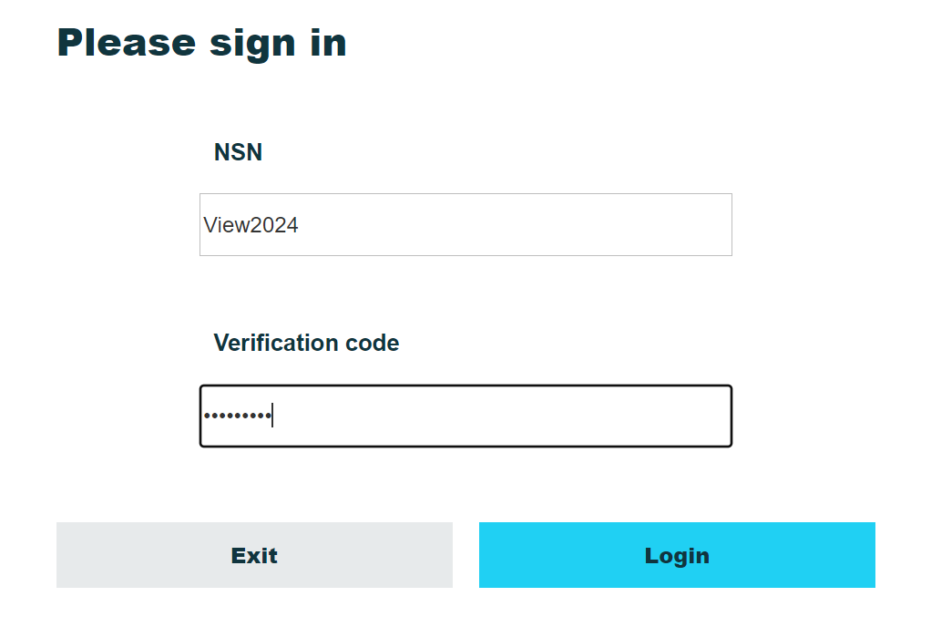
Access Past Digital Exams – contd.
NSN: View2024
Verification Code: Tw3nty/24

Slide 26
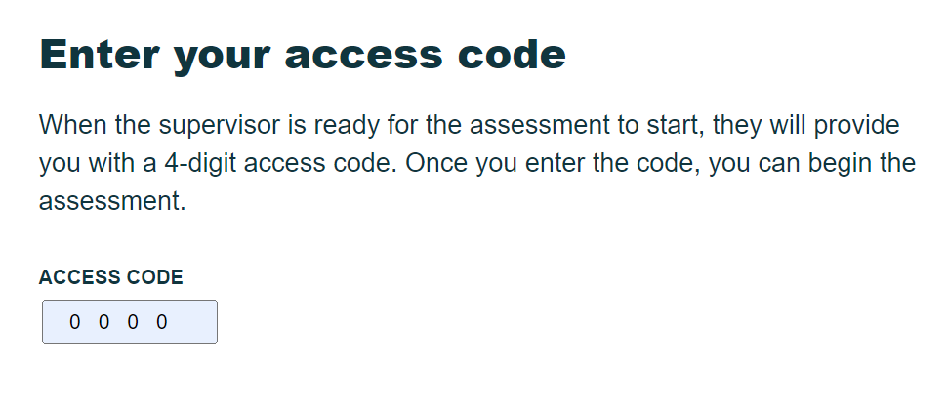
Access Past Digital Exams – contd.

Slide 27
Access Past Digital Exams – contd.
Past digital exam answers
https://www2.nzqa.govt.nz/ncea/subjects/select-subject/numeracy/
https://www2.nzqa.govt.nz/ncea/subjects/select-subject/literacy-reading/

Slide 28
Other information cont’d.
For a general overview of NCEA please refer to the “NCEA Explained Simply” on the school website. (Students & Learning/NCEA).

Slide 29
Other information cont’d.
The NZQA website has more information regarding numeracy, and literacy.
click here
https://ncea.education.govt.nz/literacy-and-numeracy/literacy/reading/unit-standard
https://ncea.education.govt.nz/literacy-and-numeracy/numeracy/unit-standard

