Slide 1
Creating and Using an NZQA Account
Notes:
A quick check can tell you if your first year of Tertiary study will be fees free.

Slide 2
Creating and using your NZQA account
The NZ Qualifications Authority (NZQA) are the government organisation that manage NCEA
All high schools in NZ send their NCEA results and exam entries to NZQA
NZQA organise the exams and the marking of them
NZQA work out which students have gained NCEA certificates and University Entrance. The also manage the Scholarship exams and folios
It is very important that you create an NZQA account.
Notes:
Actions students can complete when using their Learner login.

Slide 3
You can use your NZQA account to:
check your entries and results are accurate
order copies of your NCEA certificates
print your Record of Achievement – a very important document
update your personal details, such as email address (use a personal email address not your school email)
access the digital exam platform if you are doing digital exams
access your marked exam papers
request reviews or reconsiderations of your external exam papers by the due date.
Notes:
Actions students can complete when using their Learner login.

Slide 4
Create your NZQA login
Go to the NZQA website (www.nzqa.govt.nz) and click on Login, then Learners.
Notes:
Login
First time users must register first through this link.
Students new to NCEA will be unable to register here until their school has sent through its first submission file to NZQA, (usually by May 1st).

Slide 5
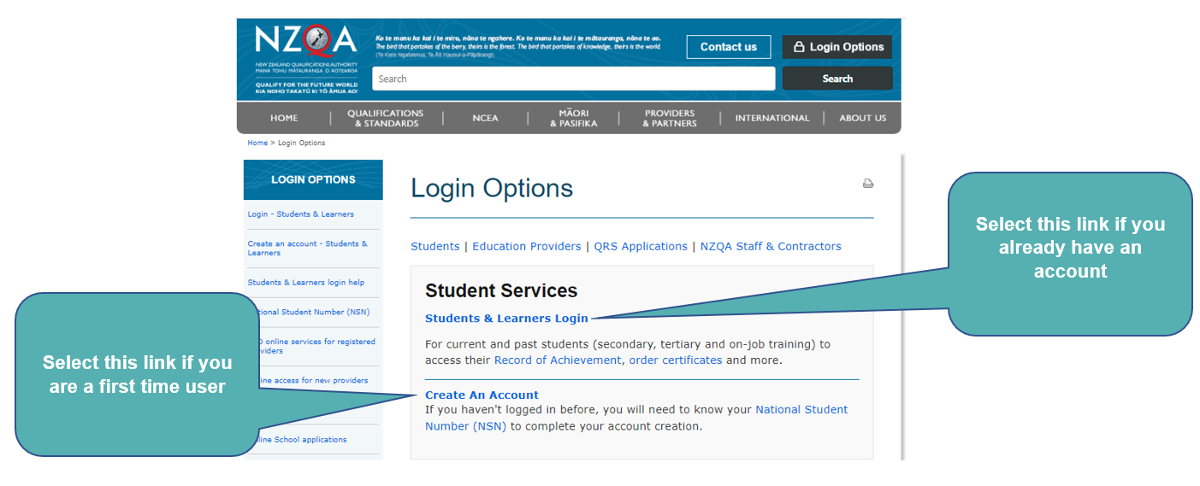
Create your login continued:
Notes:
Login
First time users must register first through this link.
Students new to NCEA will be unable to register here until their school has sent through its first submission file to NZQA, (usually by May 1st).

Slide 6
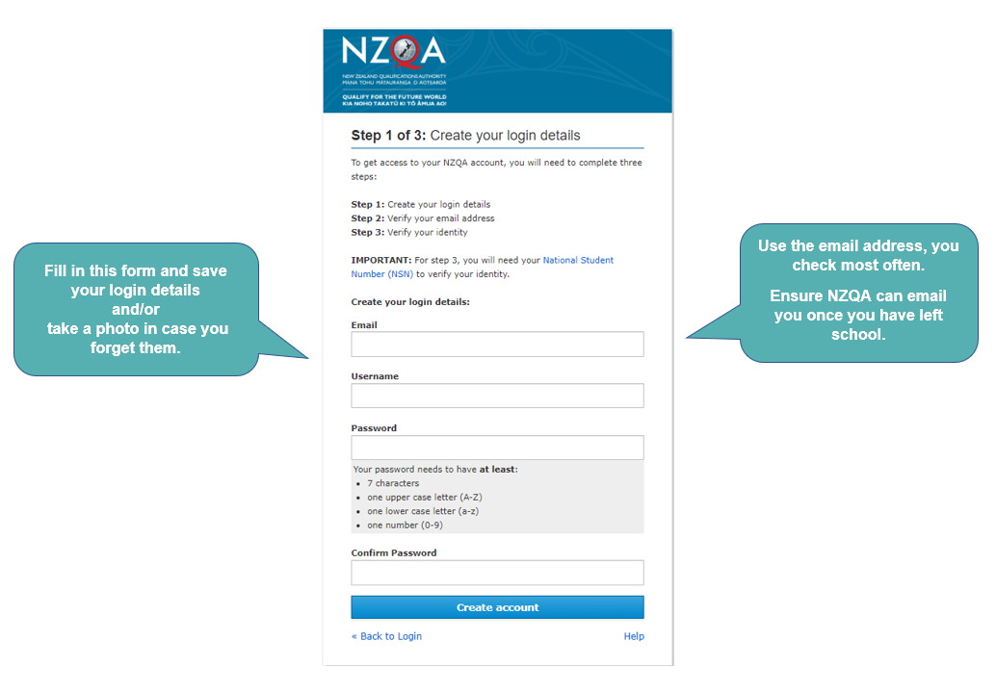
Create your NZQA account
You will need your National Student Number (NSN) to set up an account. It is a 9 digit number that can be found in the details section on the Kamar portal or, on the reverse side of your NZQA card that your Linc teacher has.
Notes:
Create an NZQA Account
You may want to use an address that will be ongoing so you can maintain access to your account in future.

Slide 7
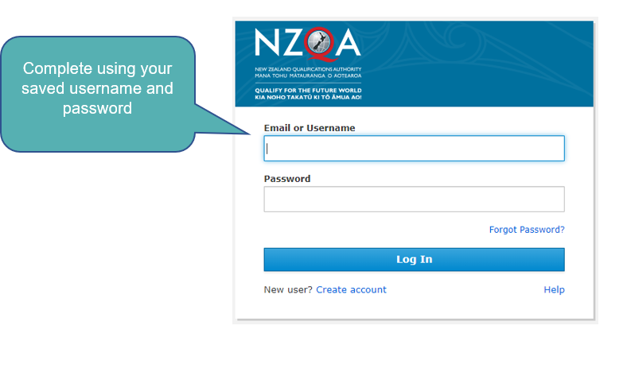
Log in to your account
Log in here, once you have created your account
Notes:
Log in to your Account

Slide 8
Password Resets
Notes:
Learner login
There are two easy ways to reset your password: by email and by using the ChatBot
Or you can phone the call centre (0800 697 296) which can help with resetting passwords or other problems.

Slide 9
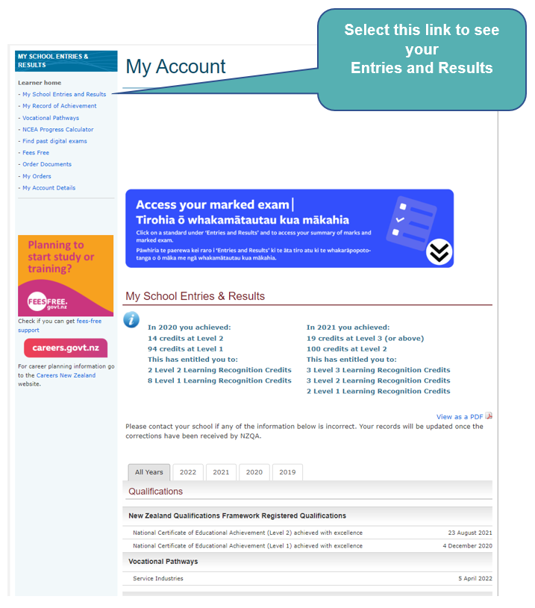
Find your Entries and Results
Notes:
Find entries and results on the sidebar

Slide 10
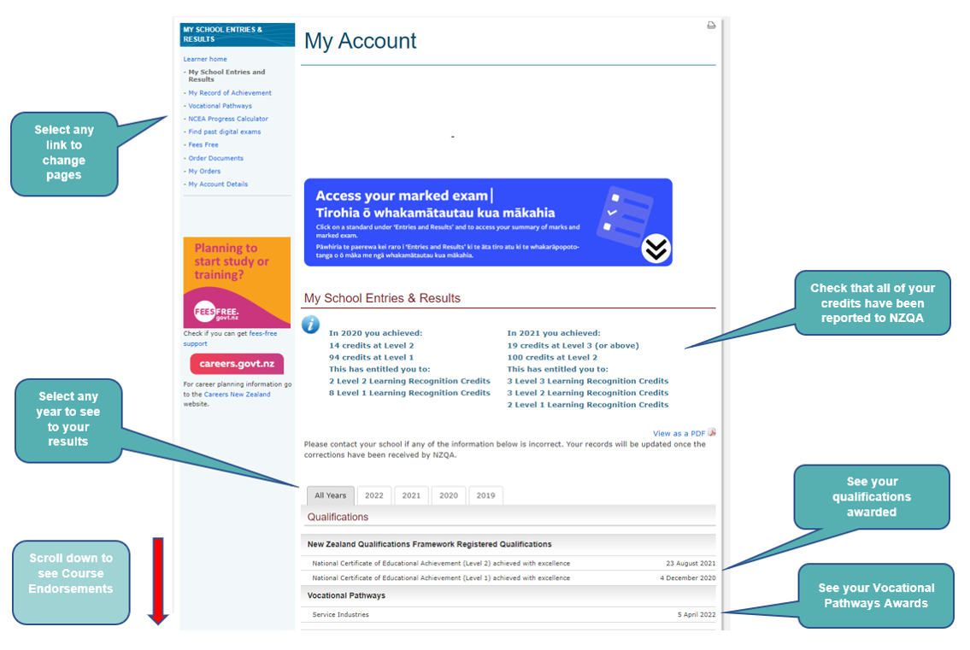
Checking your Entries and Results
Go to:
Go to:
Notes:
Learner home - My School Entries and Results
Year tabs: These allow students to quickly move between their results from individual years, as well as see a chart of their cumulative results (Credit Summary - All Years).
Qualifications, awards and endorsements only show under the All Years tab, while the Course Credit Summaries only appear under the individual year tabs (e.g. slide 12).
Scroll down for further information.

Slide 11
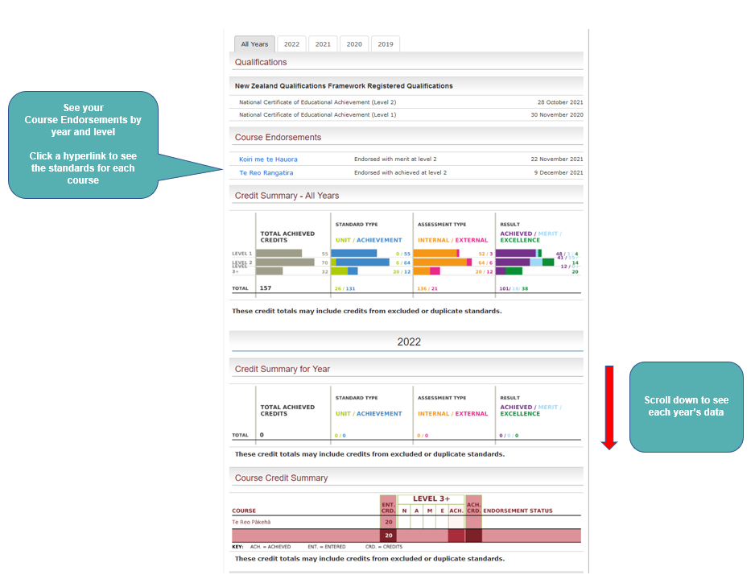
Check your Course Endorsements
Notes:
Learner home - My School Entries and Results ​
Course Endorsements (in All Years Tab)
This shows the Entries and Results for the specified course.
​
Std. - standard number (All "9xxxx" series are achievement standards and all other reference numbers are unit standards)​.
Ver. - version number for this standard.​
Asm. - assessment mode - either Internal (IN) or External (EX).​
Provider - provider code of the assessing organisation
Māori - indicates whether an external standard was completed in Te reo Māori.​
Crd. - credits achieved​
Result. - the result achieved.
Note that each standard can have a range of results including "N" for not achieved, "A" for achieved, "M" for achieved with merit, or "E" for achieved with excellence. As some standards can not be awarded all of these results, the result code is shown in bold where a candidate has achieved the maximum possible result for that standard. N - Not achieved A - Achieved M - Merit E - Excellence ABS - Absent SNA - Standard not attempted RNA - Result not yet available
Scroll down for further information.​
​

Slide 12
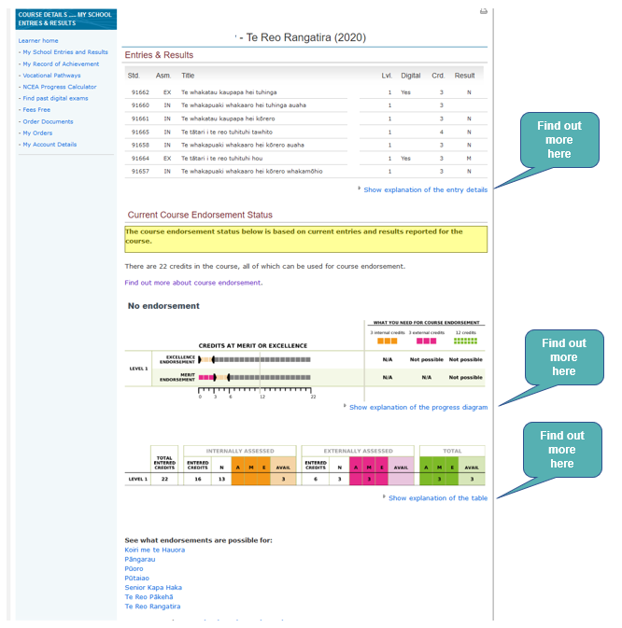
Course Endorsements in Close-up
Notes:
Learner home - My School Entries and Results
Course Endorsements (in All Years tab)
This shows the Entries and Results for the specified course.
Std. - standard number (All "9xxxx" series are achievement standards and all other reference numbers are unit standards) .
Ver. - version number for this standard.
Asm. - assessment mode - either Internal (IN) or External (EX).
Provider - provider code of the assessing organisation
Māori - indicates whether an external standard was completed in Te reo Māori.
Crd. - credits achieved
Result. - the result achieved.
Note that each standard can have a range of results including "N" for not achieved, "A" for achieved, "M" for achieved with merit, or "E" for achieved with excellence. As some standards can not be awarded all of these results, the result code is shown in bold where a candidate has achieved the maximum possible result for that standard. N - Not achieved A - Achieved M - Merit E - Excellence ABS - Absent SNA - Standard not attempted RNA - Result not yet available

Slide 13
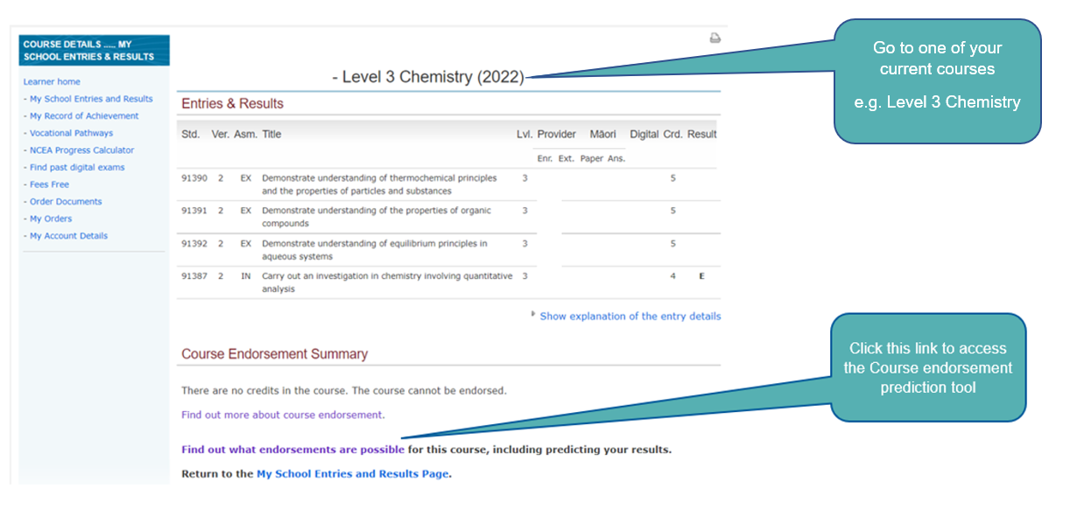
Predict your Course Endorsements
Notes:
Work out whether endorsement is possible.

Slide 14
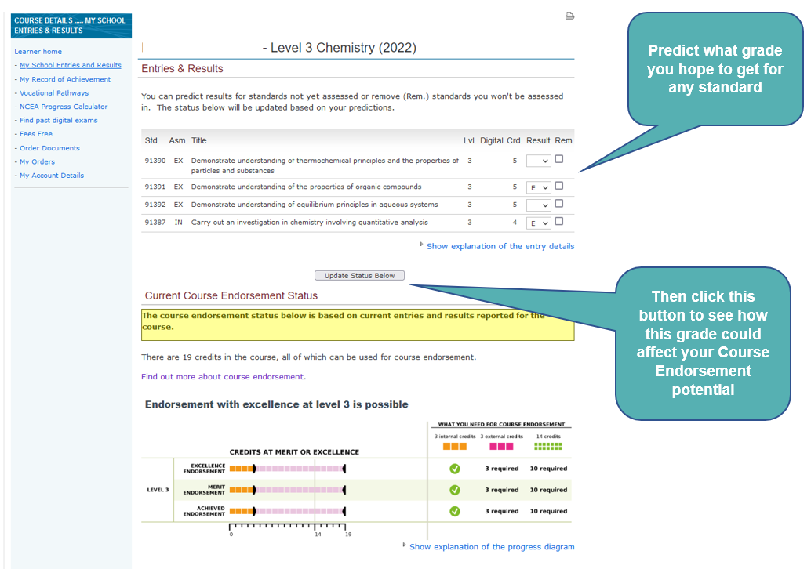
Course Endorsements Prediction Tool
Notes:
Learner home - My School Entries and Results
Predict the grade you hope to get for a course and understand how this grade will affect endorsement.

Slide 15
View your credit summary for all years
Notes:
Learner home - My School Entries and Results ​
​
From All Years tab showing Credit Summaries for All Years and one individual year.​
​
Scroll down for further information.​

Slide 16
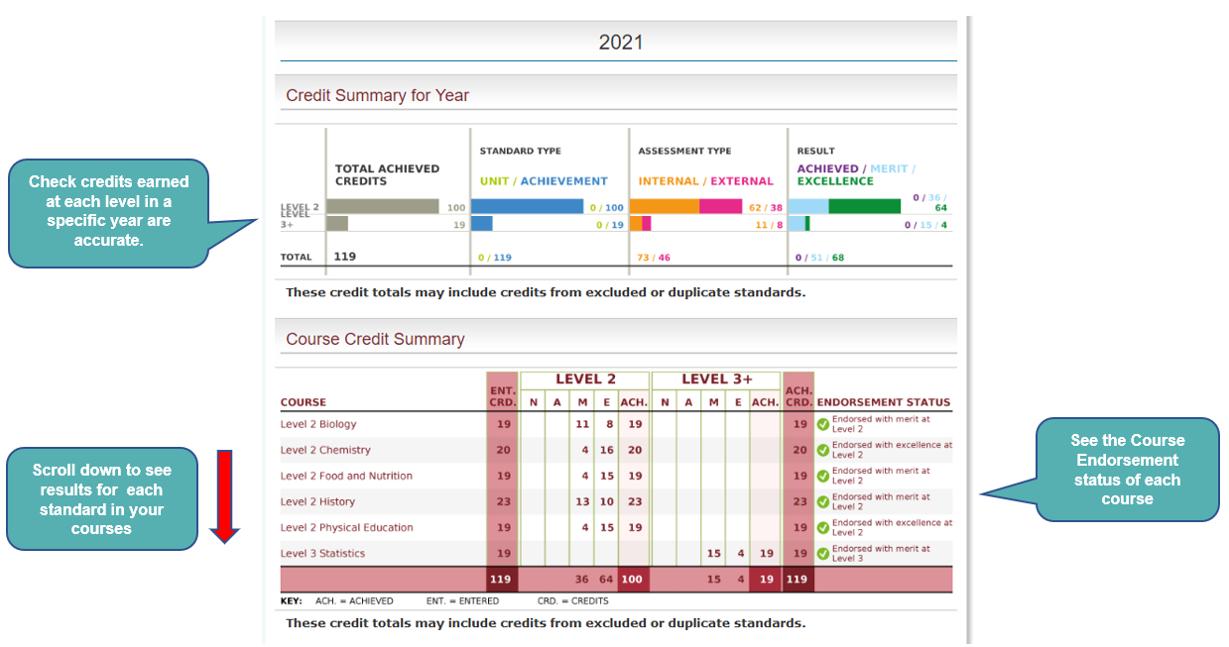
View your credit summary for a specific year
Notes:
Learner home - My School Entries and Results ​
​
Tab showing Course Credit Summary for that year. Endorsements are also indicated on the table.​
​
Scroll down for further information.​
​

Slide 17
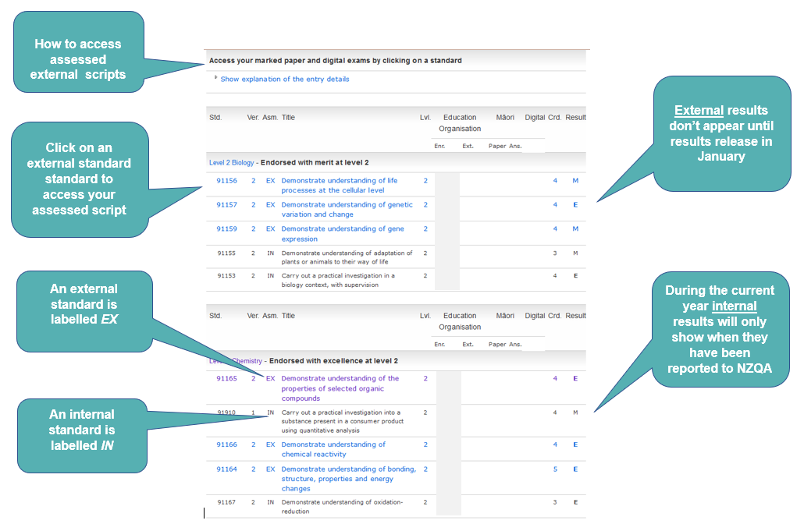
View results for assessed standards within a course
Notes:
Learner home - My School Entries and Results ​
EX - externally assessed standards ​
This shows the standards currently entered in for the end of the year exams. ​
Students should check these entries carefully for accuracy before the end of August. ​
The 1 September data file to NZQA confirms all entries into externally assessed standards including Scholarship for candidates to receive personalised papers.​
No withdrawals from externally assessed standards can be made after September 1st.​
Results will be entered for these standards at the completion of the NZQA external examination process.​
​
IN - internally assessed standards.
Competed internally assessed standards show the result and if applicable the number of credits gained. ​
No withdrawals from internally assessed standards can be made after 1 December ​
​
Education Organisation​
Enr. – Enrolled school. This is the code of the ‘home school’ of the student, the school they are enrolled in. ​
Ext. – Where assessment is undertaken with an outside provider, the outside provider code will show here. e.g. If 498 were shown in the grey column above this would mean assessment had been undertaken through Te Kura / The Correspondence School. ​
​
​

Slide 18
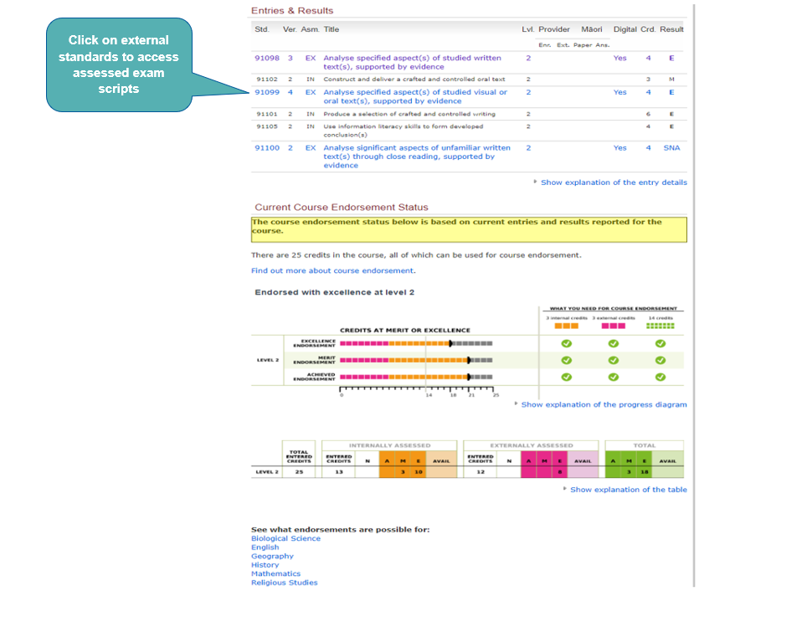
Access marked exam papers
Notes:
Access assessed scripts through the Entries and Results area by clicking on the standards in blue.
They turn purple once they have been accessed.

Slide 19
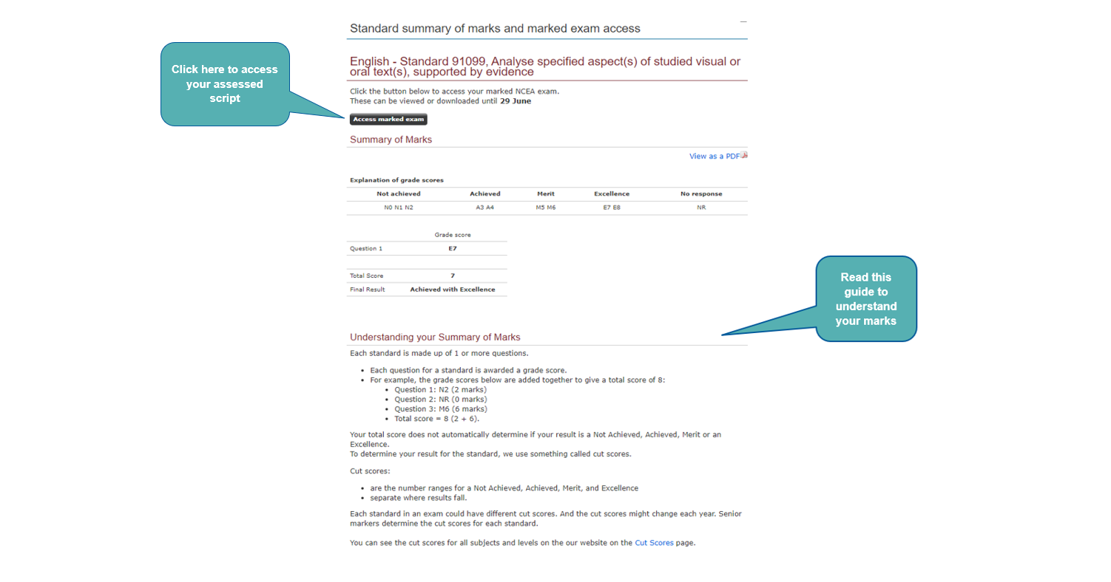
Access your marked exam papers - continued
This button takes you to your assessed script
Notes:
The next page provides the standard summary of marks and assessed script access

Slide 20
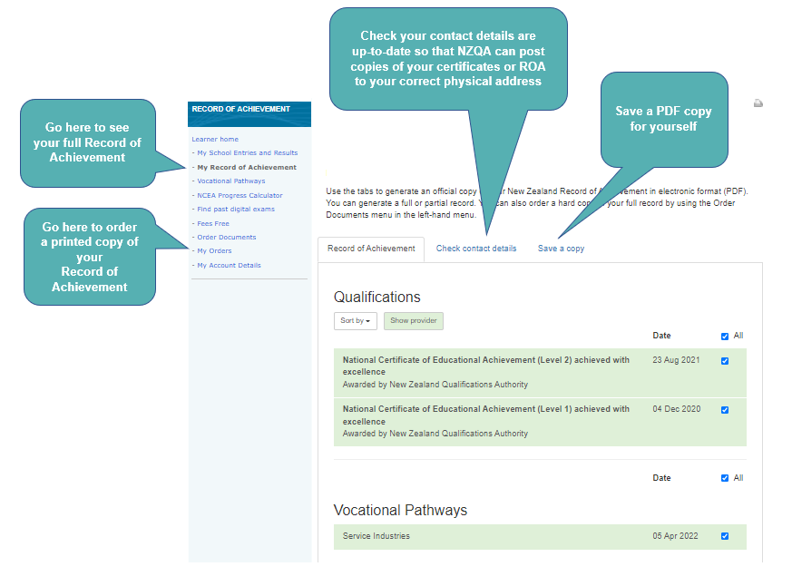
Your Record of Achievement (ROA) - Important
Notes:
You can save a copy of your Record of Achievement and/or order a printed copy from NZQA through the Order Documents hyperlink in the side bar.

Slide 21
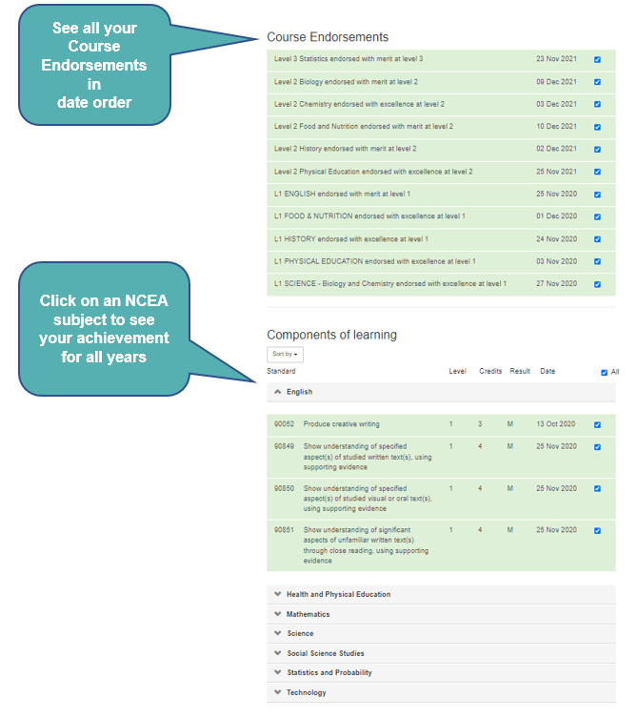
More about your ROA
Important Note: You Record of Achievement (ROA) is a summary document showing every NCEA result that is at Achieved, Merit or Excellence level. It does not list a Not Achieved grade. The ROA also lists what NCEA certificates you have obtained along with University Entrance.
This document is of interest to employers and Tertiary organisations.
It is important to remember, if some of your results don’t go to plan and you end up with a Not Achieved, it won’t appear on your ROA. So, don’t avoid sitting external exams because you are concerned about gaining a Not Achieved.
Notes:
There are different ways to view a student's results through the Record of Achievement.
For example, you can see Course Endorsements in Date Order or view achievement in a particular NCEA subject for all years.

Slide 22
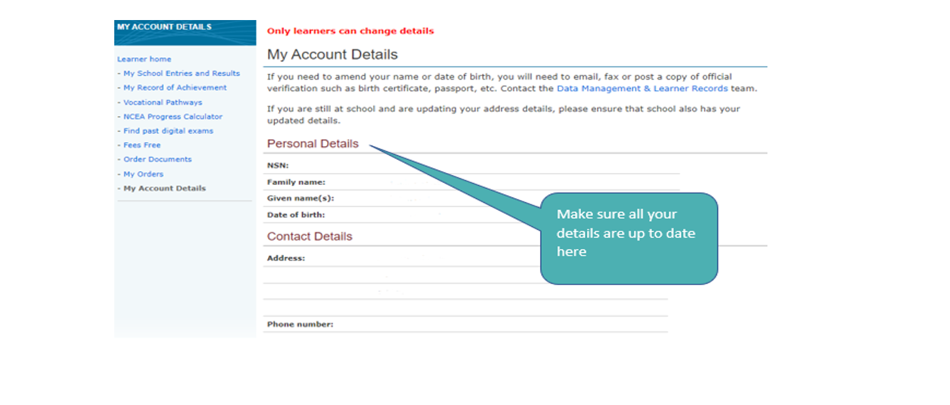
Keep your details up-to-date
Notes:
Keep details updated in My Account Details. In particular it's important to ensure you are using an email address NZQA can contact you on after you have left school.

Slide 23
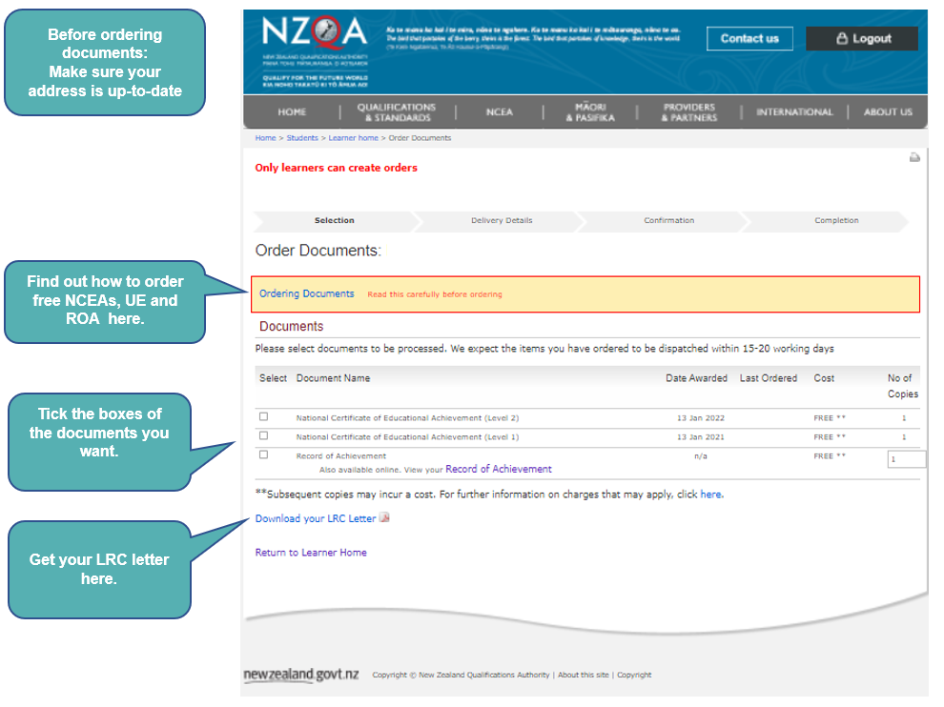
Ordering NCEA Certificates and Other Items
Your NCEA certificates don’t get sent to you unless you order them using your NZQA login account.
The first copy of each NCEA certificate is free. Make sure your mail address in your personal details is correct so the certificates are sent to your place.
Notes:
Many certificates & qualifications documents are free if you order them in the year of study. If you leave it till later, you may incur a fee.

Slide 24
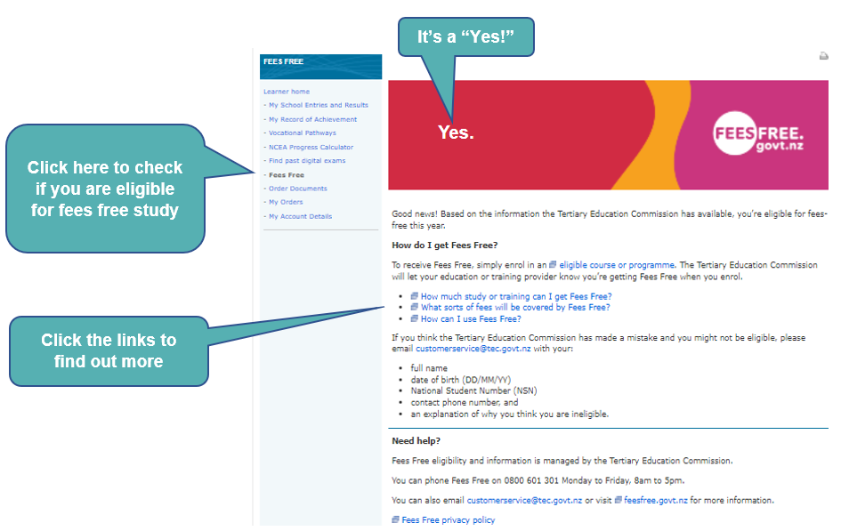
Check if you’re eligible for Fees Free Tertiary Study
Notes:
A quick check can tell you if your first year of Tertiary study will be fees free.

Slide 25
The End
Notes:
A quick check can tell you if your first year of Tertiary study will be fees free.

