Slide 1
English Semester Options for Year 11
2020

Slide 2
Taking at least two semester courses in English is COMPULSORY in Year 11.
Luckily you have lots of choice.

Slide 3
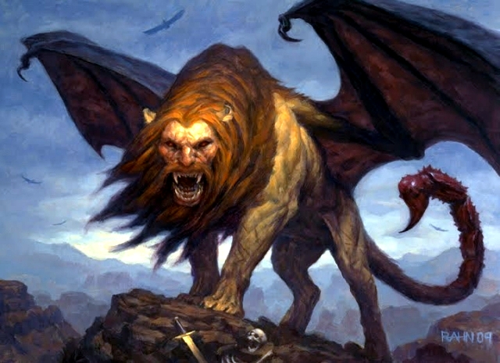
11ENM – Myths and Legends

Slide 4
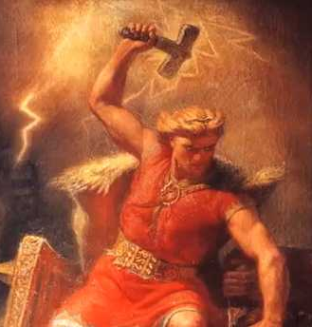
Hercules, Perseus, Thor, Prometheus, Māui. Want to know what these heroes have in common?
This semester course will explore the Myths and Legends of Ancient Cultures while teaching you how to think more deeply about why they existed in the first place.
This course will draw connections across seemingly disconnected cultures through their myths.

Slide 5
Restrictions:
These courses offer the same achievement standard:
The Art of War (11ENA)
English in the Outdoors – part 2 (11ENO b)

Slide 6
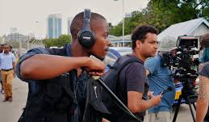
Just the Facts: Documentary in English 11END
Love knowing what’s going on in the world and what can be done about it? This semester course focuses on teaching research literacy skills, by investigating controversial topics explored through the media and literature.
Emphasis will be on how to use sources to effectively gain information whilst recognising bias and reliability.
Students will have a choice as to whether they present their learnings through a written report or orally as a podcast, group presentation, radio programme or speech.
Restrictions:
This course offers the same achievement standard:
English in the Outdoors (Semester A)

Slide 7
Look Closer: Visual English - 11ENV
Love going to the movies? This semester course will teach students about visual language.
They will learn the components of both static and moving images and how we are manipulated daily by these.
This course will include a study of a novel (i.e. a graphic novel or a novel that has been turned into a film), alongside the study of a feature length film.
Students will showcase their knowledge of visual language through close viewing of film and a final presentation of either static or moving images that they have created.

Slide 8
Loving Literature: Reading in English 11ENR
Can’t get enough of books? This semester course focuses on nurturing and expanding a love of reading.
Students will be reading a combination of short, extended, written, oral and visual texts; delving into the deeper meanings and responding to these on a personal level.
Some texts will be teacher-selected but the majority will be student-selected.

Slide 9
The ‘Write’ Stuff: Writing in English 11ENW
Love writing? This semester course is dedicated to creative and formal writing.
Learn new ways to express yourself and how to persuade people of your opinion.
Students will choose whether they present a piece of creative writing or formal writing for assessment.
This course will also have a focus on grammar and spelling and how being clear in meaning is crucial to being successful.

Slide 10
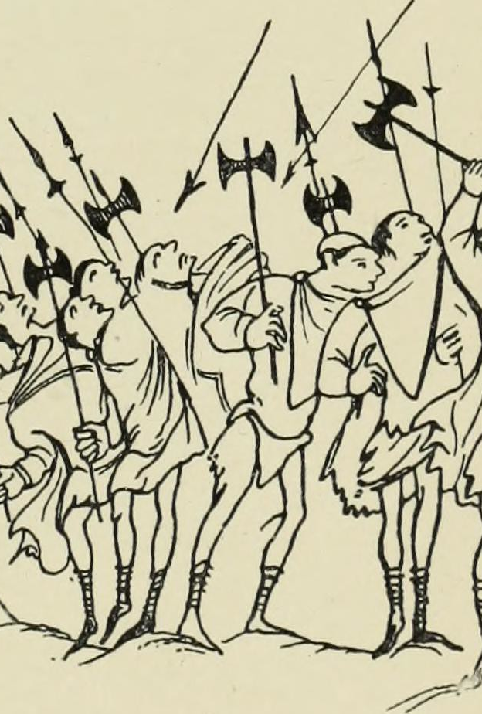
The Art of War - 11ENA
Why read and view about war for an entire semester? Why give so much attention to the literature produced by those who were there?
This semester course, named after an ancient Chinese text by Sun Tzu, focuses on the horror and reality of war, how war effects those involved and some of the reasons why we go to war.
The course will take in a film and a range of short written texts on the wars of the 20th and 21st centuries.
Students have the opportunity to delve into an area of interest they wish to explore for their Connections Across Texts assessment, such as the Vietnam War, the Holocaust, the World Wars or recent conflicts, such as the War on Terror.

Slide 11
Restrictions
These courses offer the same achievement standard:
Myths and Legends (11ENM)
English in the Outdoors – part 2 (11ENO b)

Slide 12
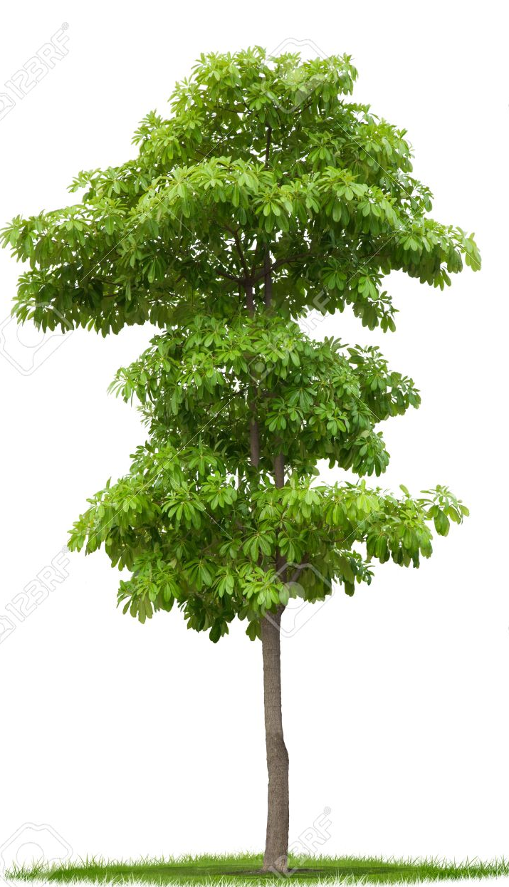
English in the Outdoors – part 1 11ENO a
A full year course with an entry and exit point and the changeover between semesters. This is a course where learning experiences and class texts will centre around the outdoors.
ENOE1A: English in the Outdoors A – Environmental Issues
We will explore tramping, hunting, fishing and riding within an Education context. There is a focus on communication and collaboration between students. We will use our incredible local area and environment to experience the outdoors and develop reading, writing, evaluating and speaking skills.

Slide 13
English in the Outdoors – part 2 11ENO b
A full year course with an entry and exit point and the changeover between semesters. This is a course where learning experiences and class texts will centre around the outdoors.
ENOC1A: English in the Outdoors B - Connecting with our Environment
Throughout this English course we will explore outdoor and environmental issues as well experiencing what our local environment has to offer. There is a focus on communication and collaboration between students as we learn and develop reading, writing, viewing and speaking skills.

Slide 14
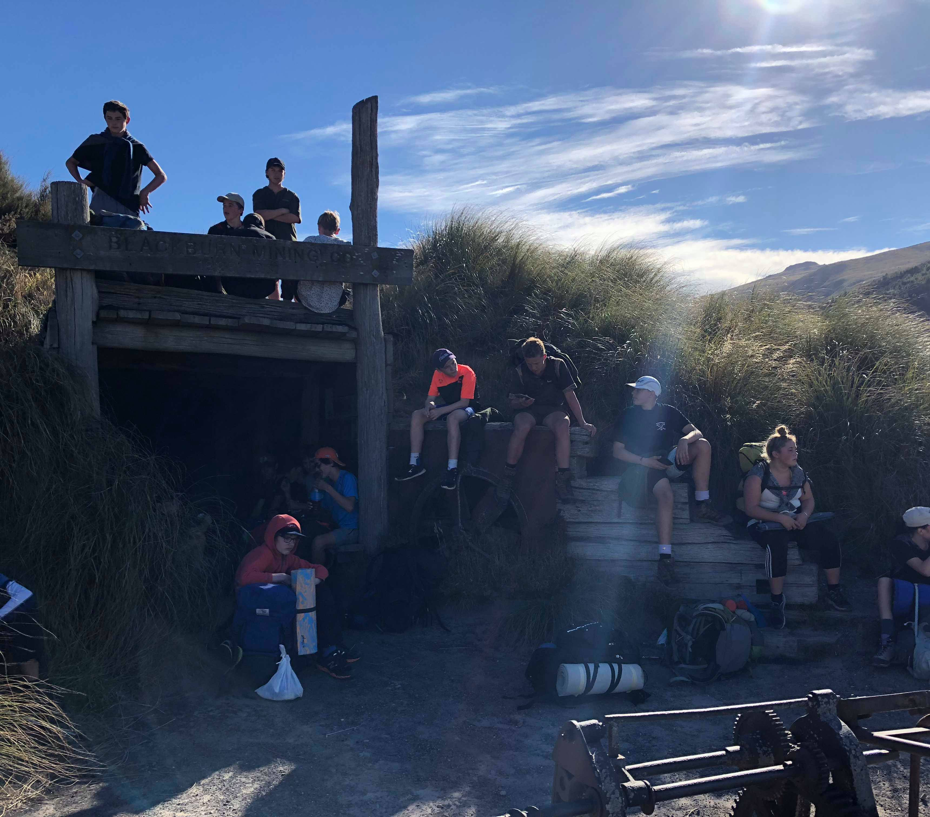
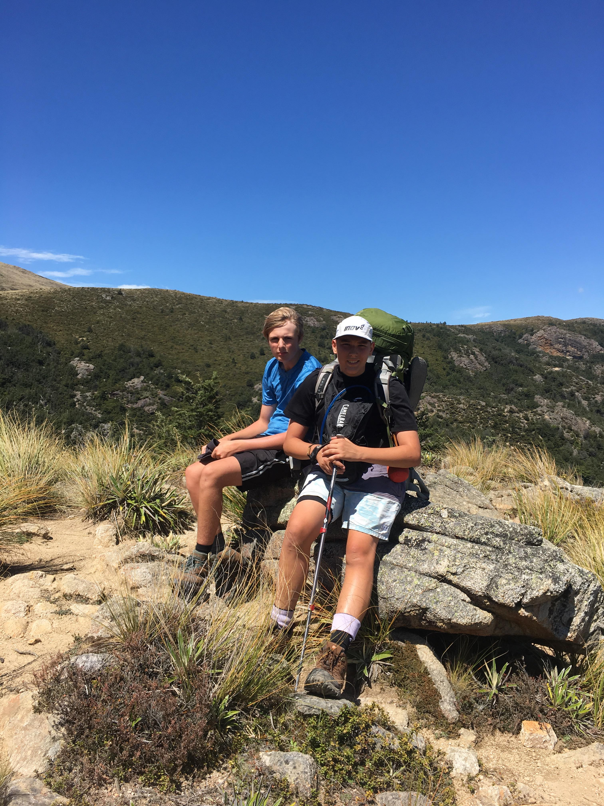
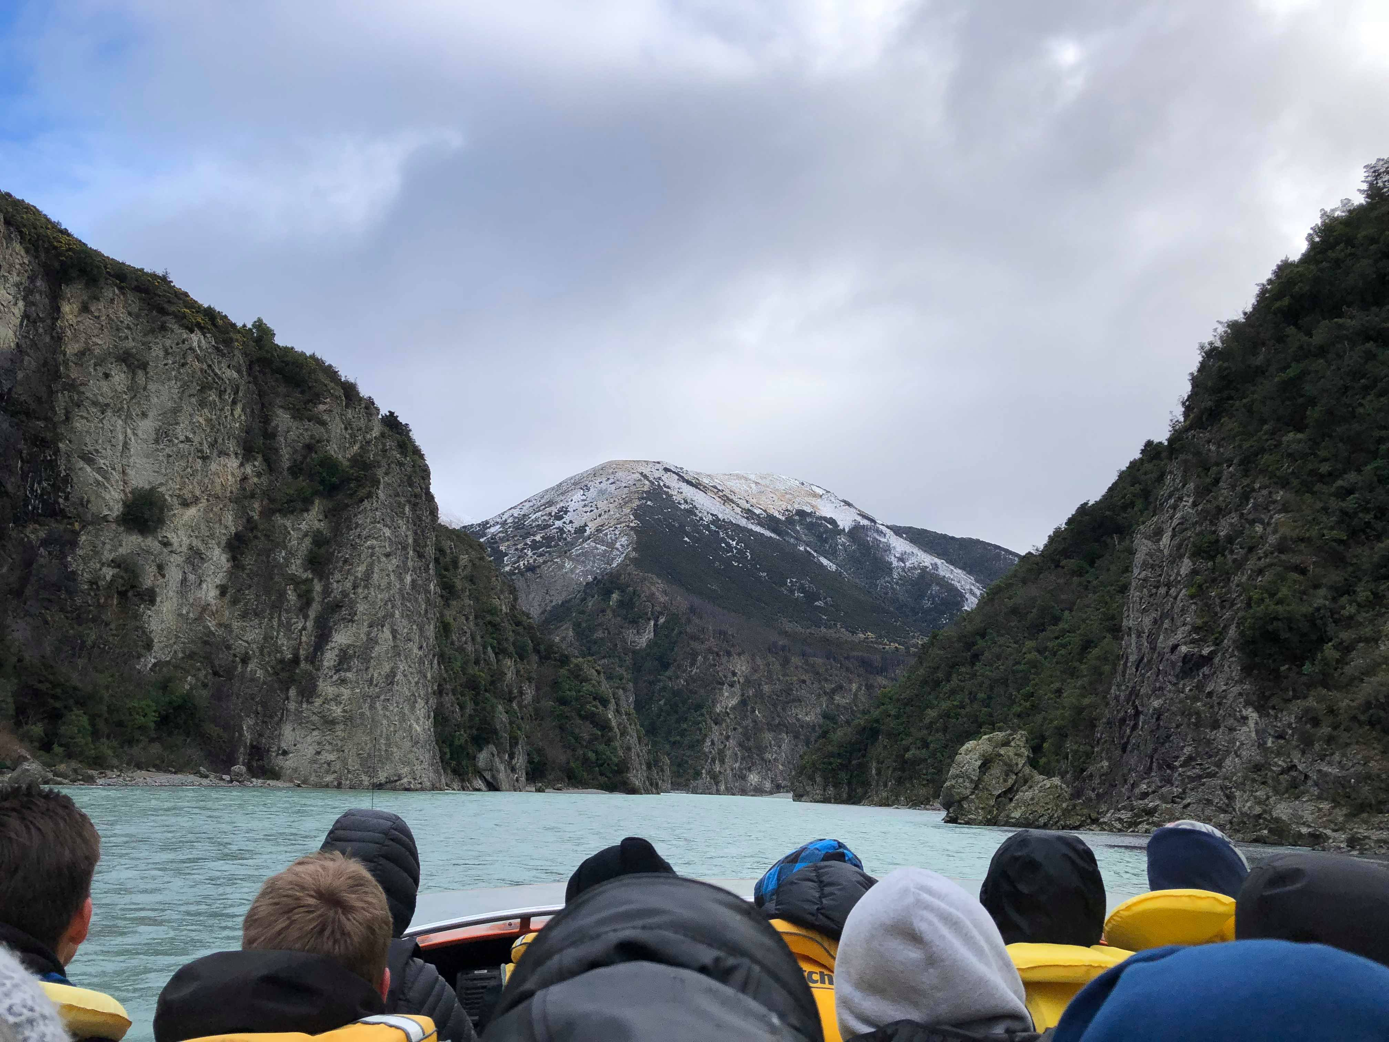
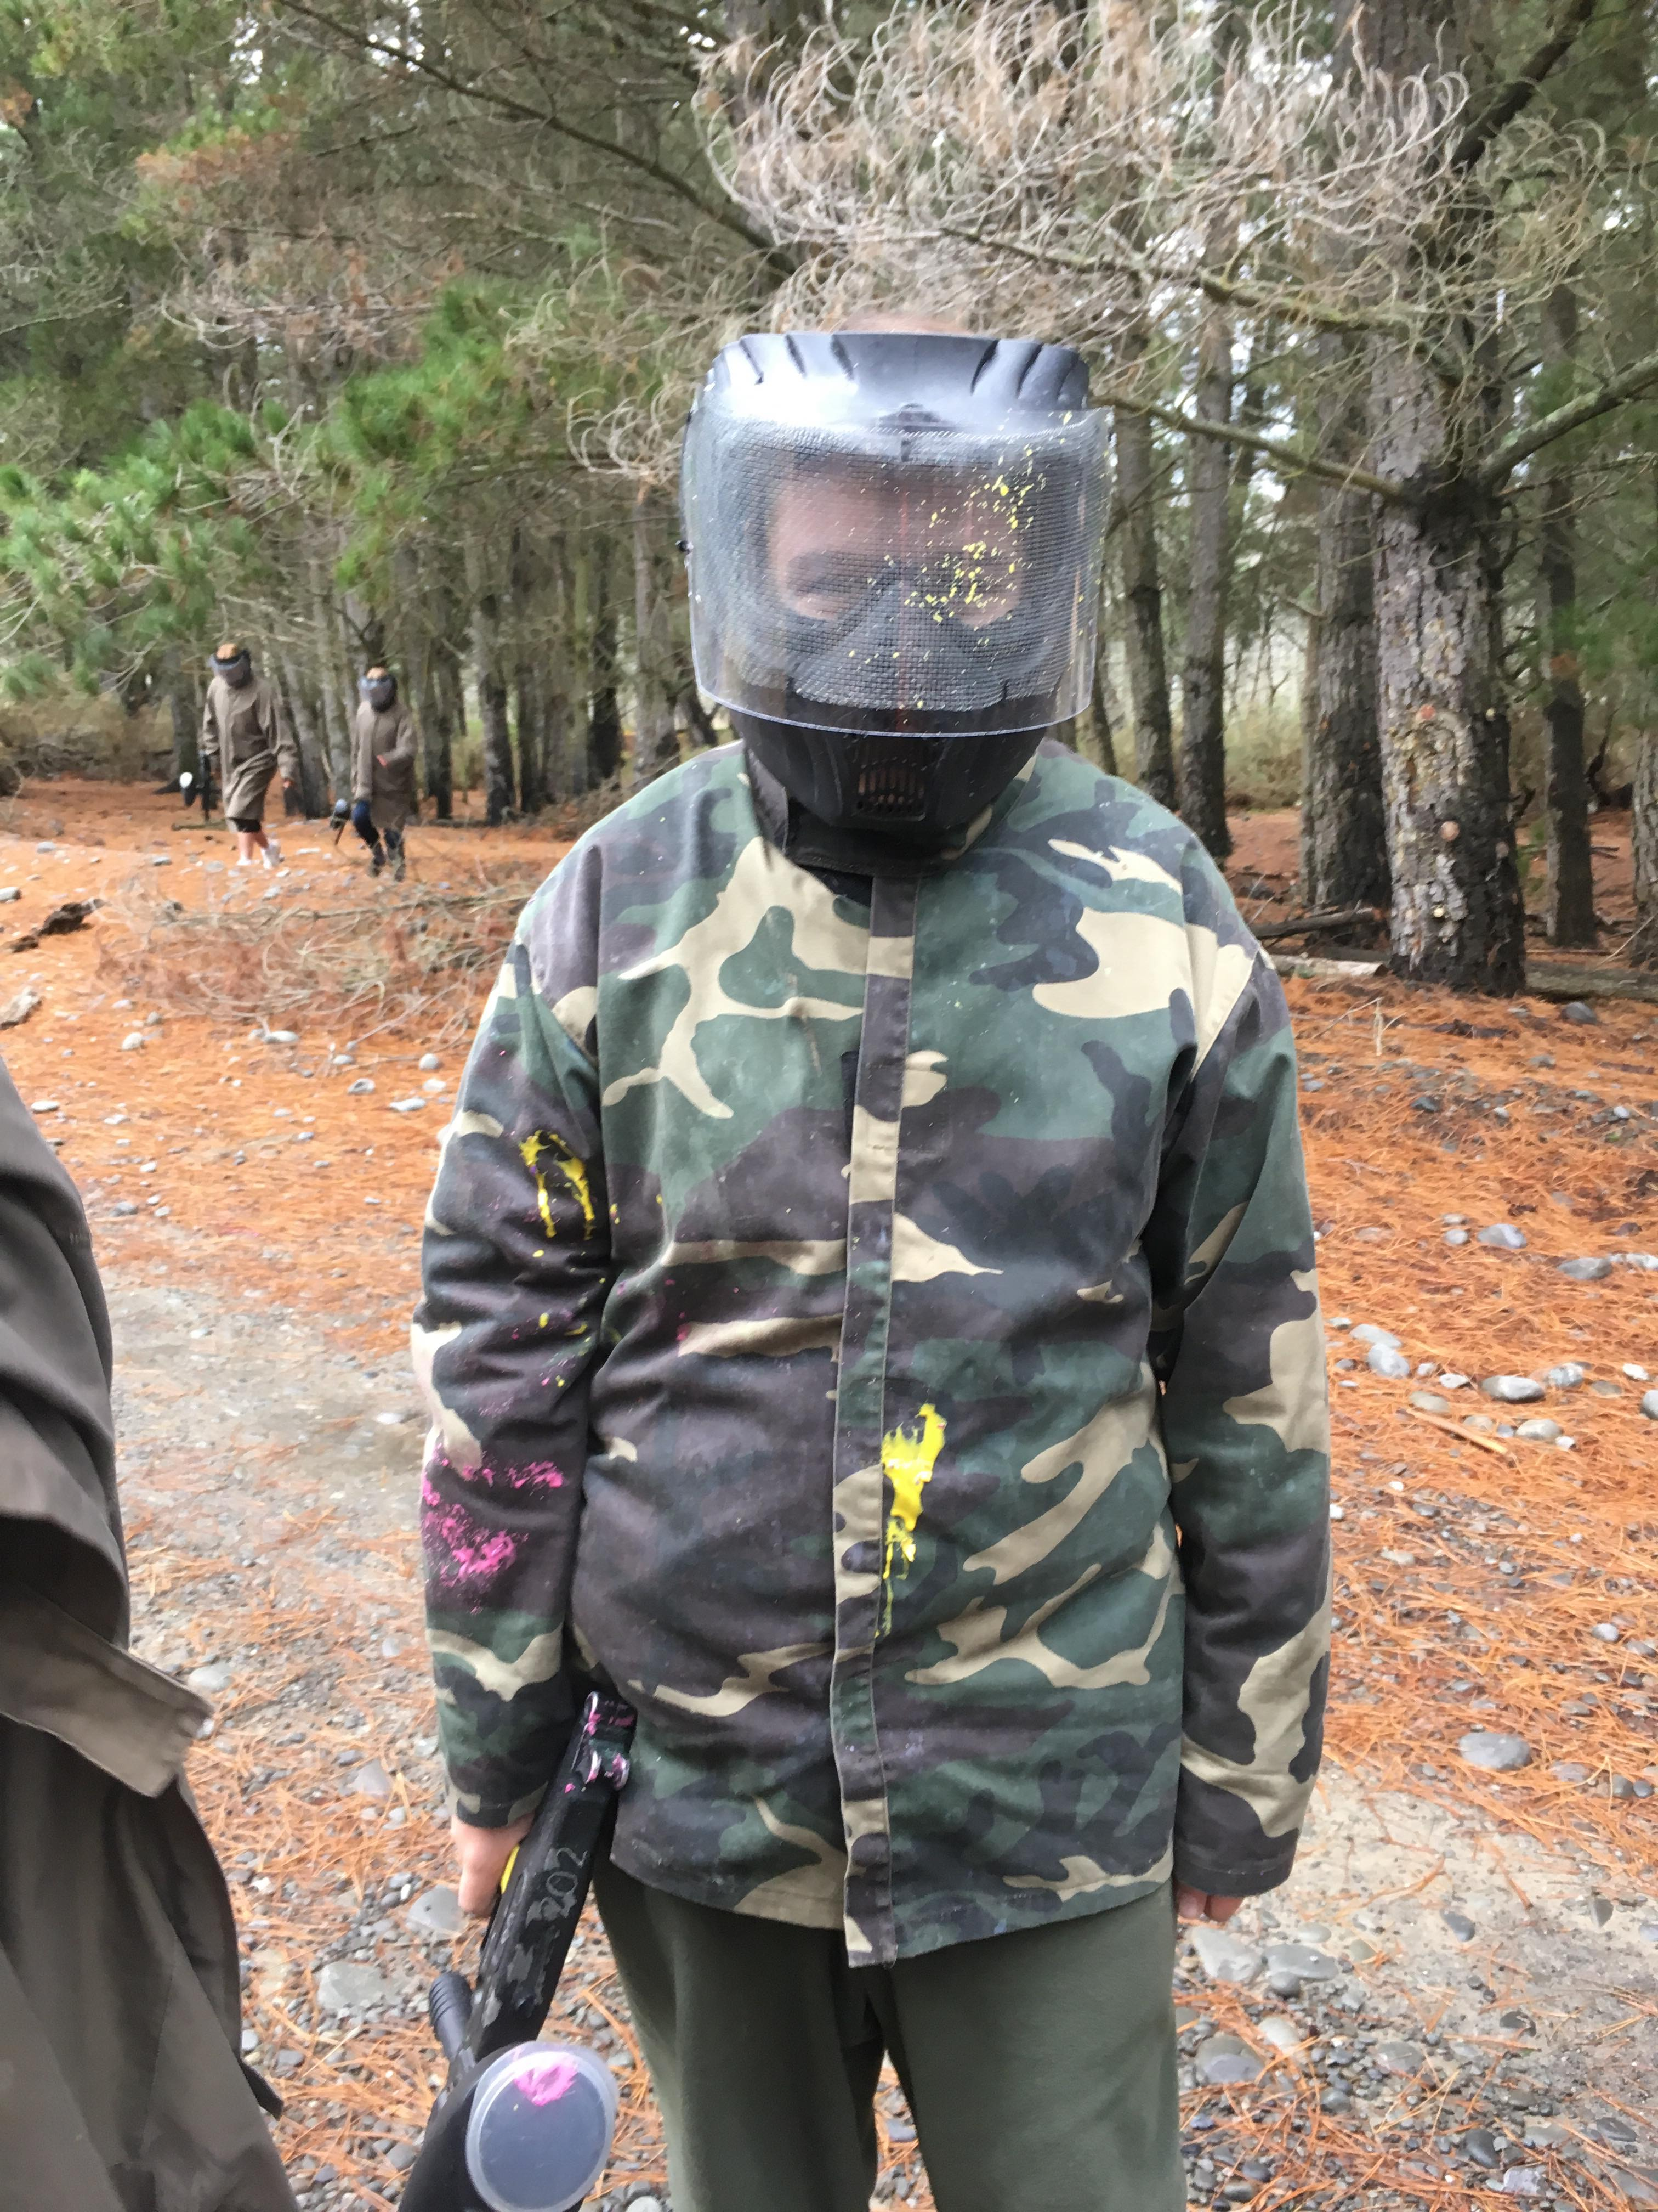
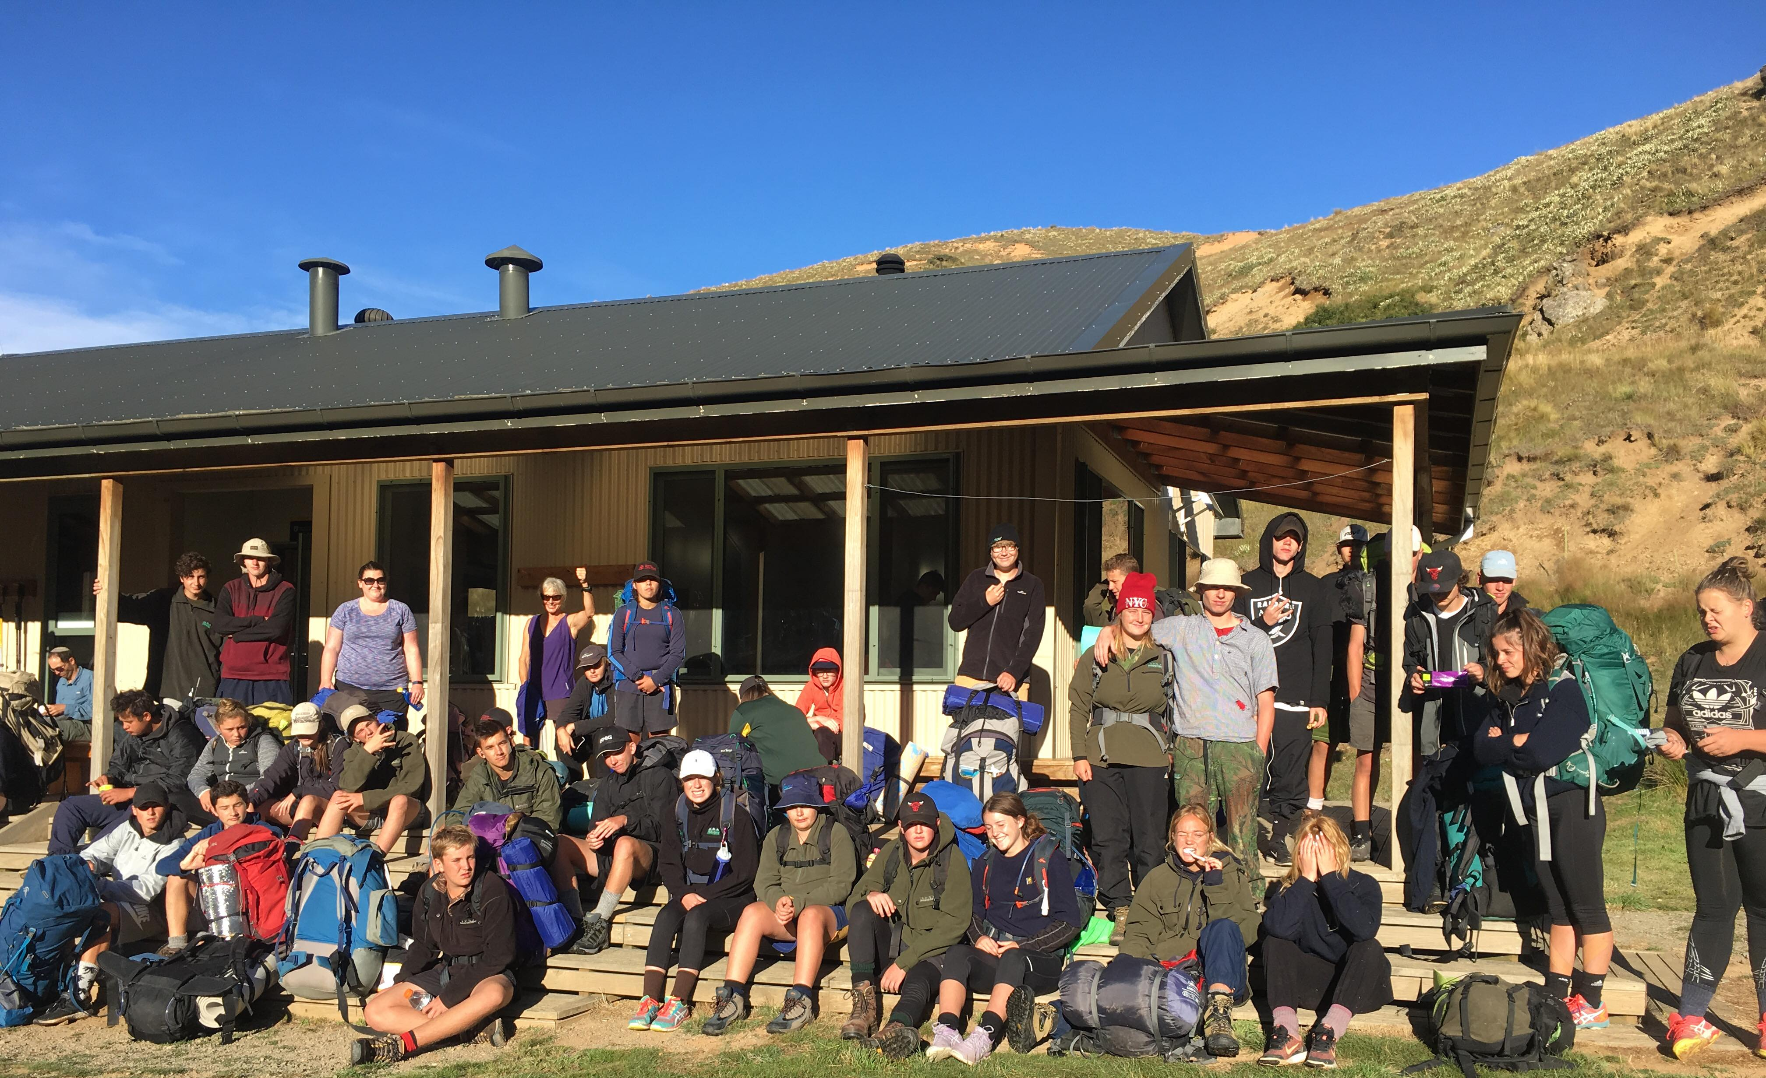
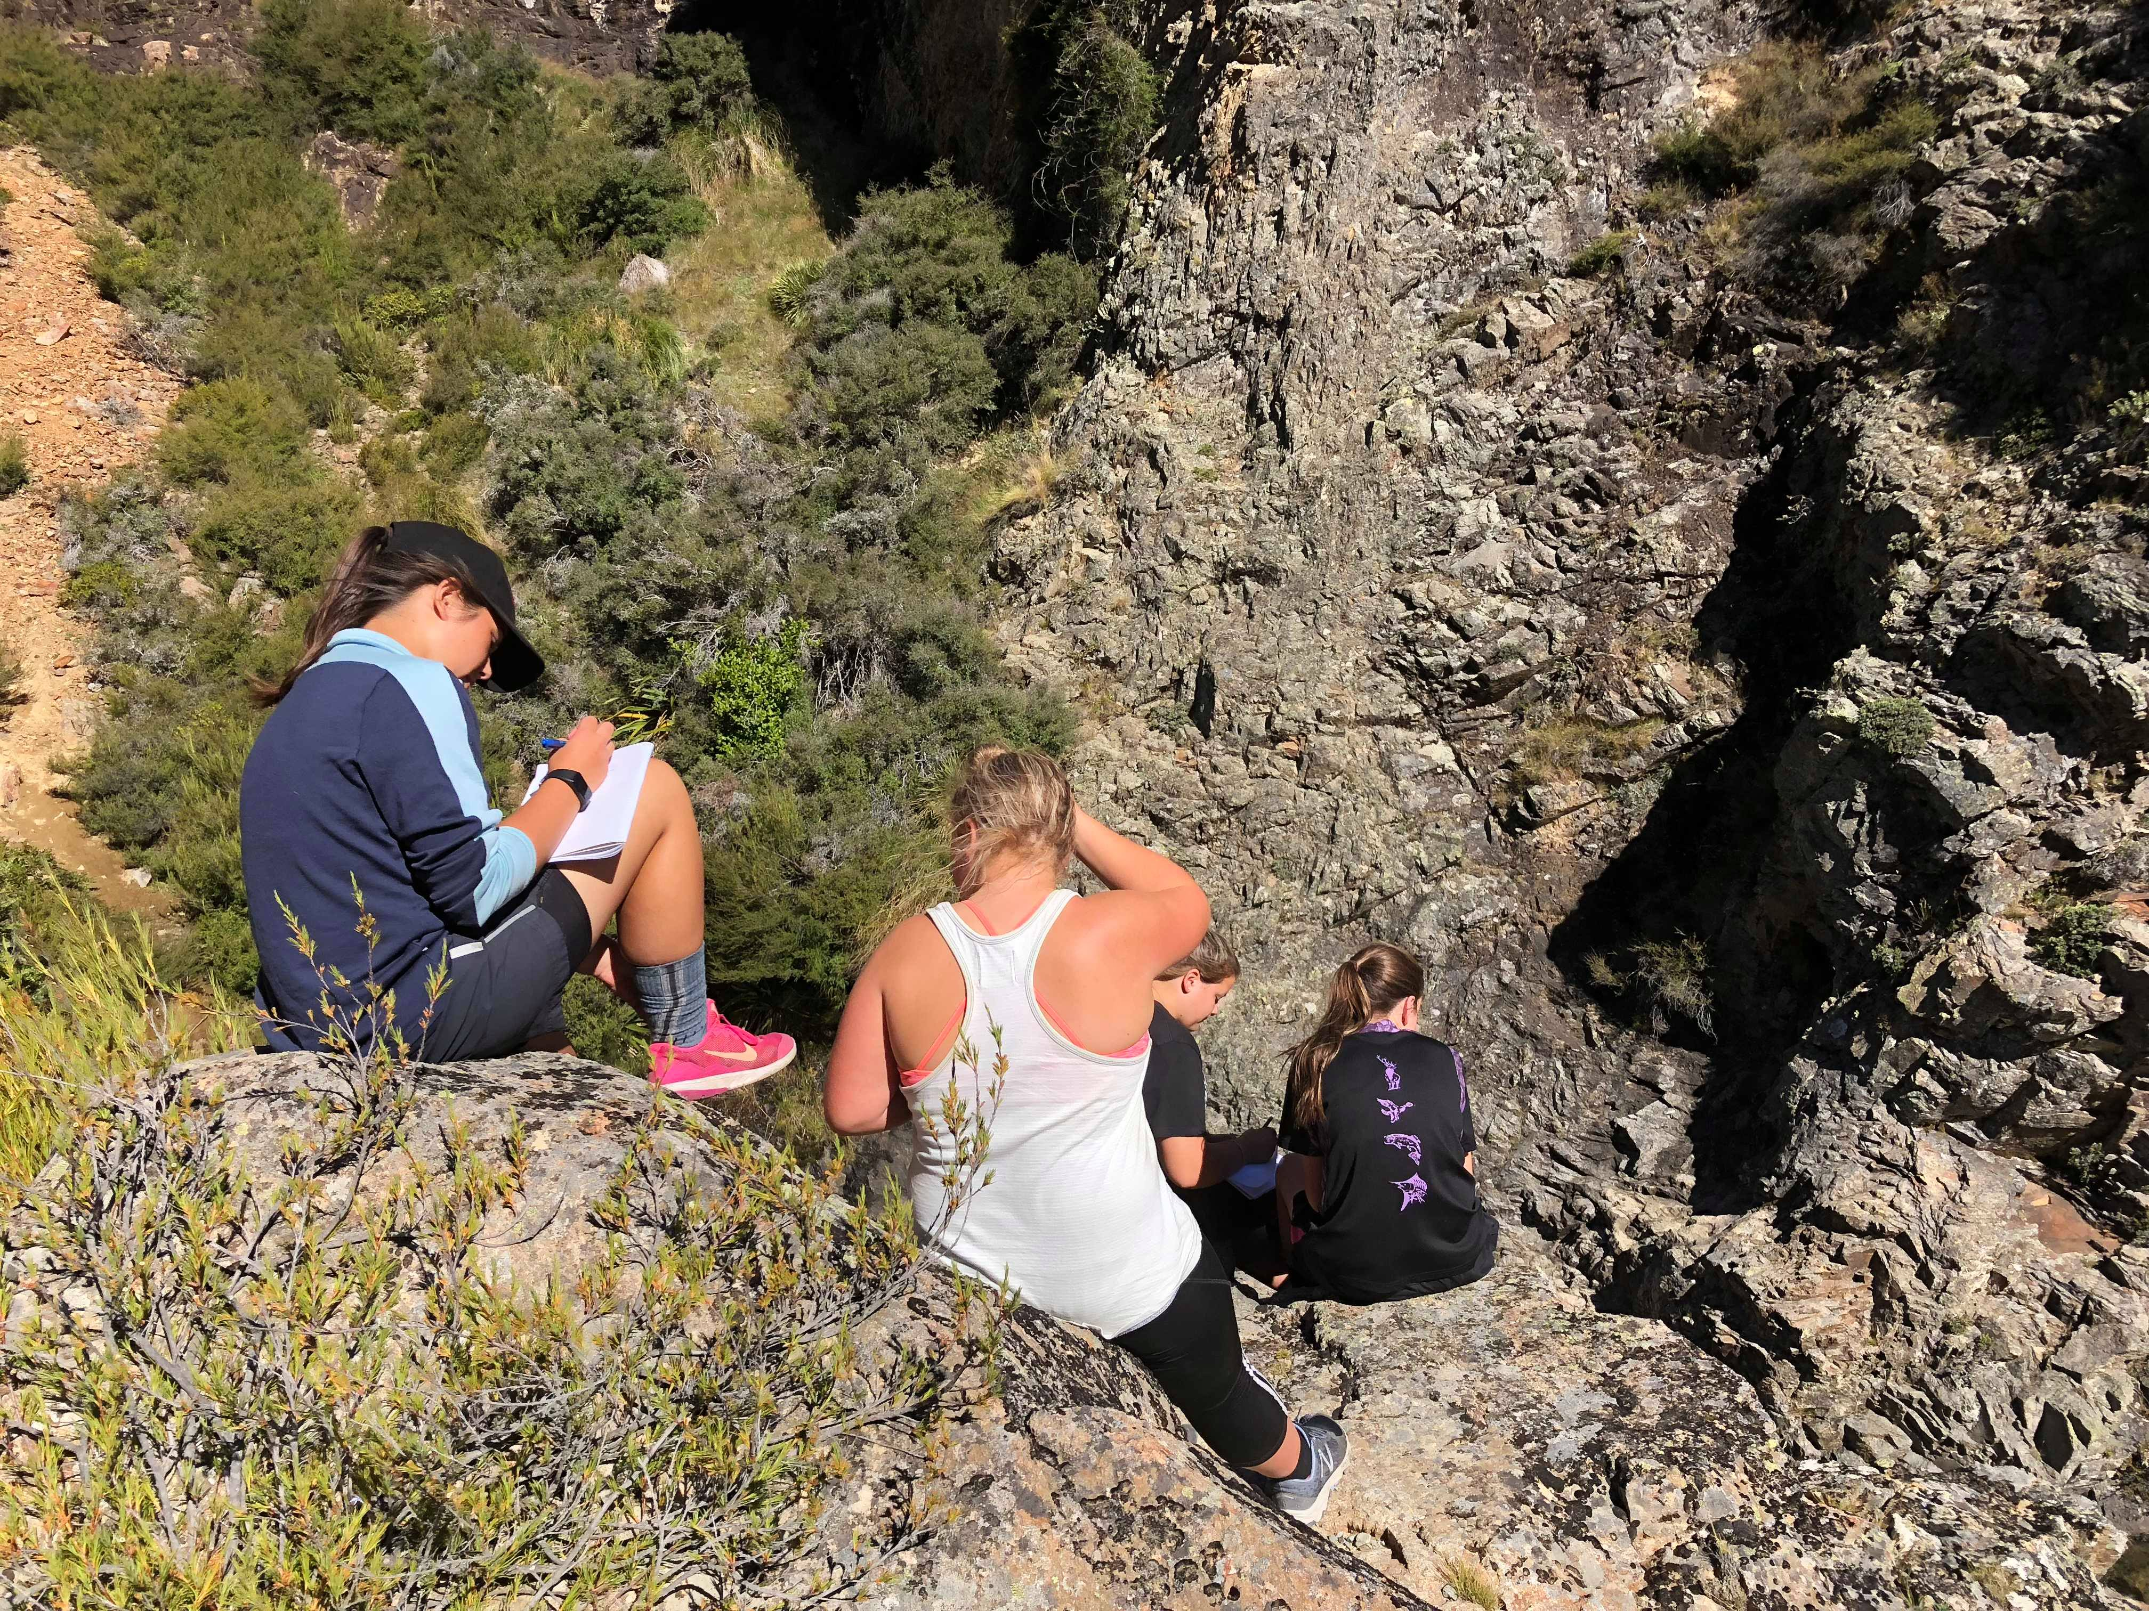
Overnight tramp into Woolshed Creek
Jetboating on the Waimakariri River
Paintball at McLeans Island

Slide 15
Restrictions
11ENO a
This course offers the same achievement standard:
Just the Facts: Documentary in English
11ENO b
These courses offer the same achievement standard:
Myths and Legends
The Art of War

Slide 16
Literacy in English - parts 1 & 2 Full year course – 11ENL a & b
This is a full year course designed to support students who need to build their literacy. Students will learn how to solve problems and work co-operatively through a range of projects.
Each term has a project focus which allows students to create, view and explore a range of texts.
Students will be assessed internally throughout their different project work to form the Literacy Unit Standard Package.
There will be an exit and entry point for this course at the semester changeover.
Students need to pass all three unit standards to gain Level 1 literacy.

Slide 17
In Summary
Taking at least two semester courses in English is COMPULSORY in Year 11. Luckily you have lots of choice.
You can choose –
11ENM – Myths and Legends
11END - Just the Facts: Documentary in English
11ENV - Look Closer: Visual English
11ENR - Loving Literature: Reading in English
11ENW - The Write Stuff: Writing in English
11ENA - The Art of War
11ENO a and 11ENO b – English in the Outdoors - parts 1 & 2 (full year with exit/entry point after semester 1)
11ENL a & b – Literacy in English- parts 1 & 2 (full year)

