Slide 1
NCEA (National Certificate of Educational Achievement)

Slide 2
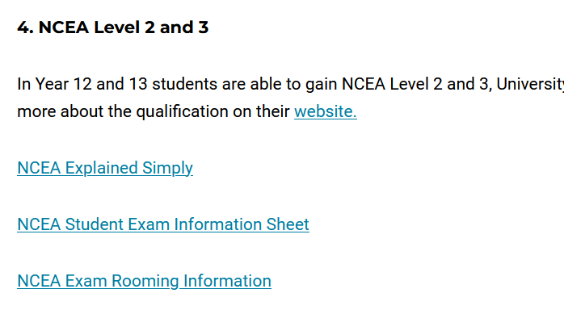
This presentation is on our website
The presentation

Slide 3
How NCEA Works
The National Certificate of Educational Achievement (NCEA) is the main qualification for secondary school students in New Zealand.
NCEA is recognised by employers, and used for selection by universities and polytechnics, both here in New Zealand and overseas.
The qualification is managed by NZQA (New Zealand Qualifications Authority)

Slide 4
YEAR 10 &11
We don’t focus on NCEA Level 1
Year 10/11 students sit the digital literacy & numeracy exams. These are needed for NCEA Level 2 and Level 3
For more details regarding the Literacy & Numeracy exams please refer to the “NCEA Literacy & Numeracy Explained Simply” on the school website (Students & Learning/NCEA)

Slide 5
YEAR 12
Complete NCEA Level 2
Students require:
60 Level 2 (or 3) credits
10 numeracy and 10 literacy credits – from Year 10/11

Slide 6
YEAR 13
Complete NCEA Level 3
Students require:
60 Level 3 credits
10 numeracy and 10 literacy credits – from Year 10/11

Slide 7
University Entrance (UE) – the minimum requirement to gain entry to most university degrees
NCEA Level 3
&
14 credits in at least three approved University Entrance subjects
&
UE literacy -10 Literacy credits at NCEA Level 2 or 3 made up of at least 5 in reading and 5 in writing
&
Numeracy - 10 credits (from Yr10/11)

Slide 8
Achievement Standards (topics) & Grades
Internal (during the year) and External (end of the year) Assessments
Excellence
Merit
Achieved
Not Achieved

Slide 9
Unit Standards (topics) & Grades
Internally (during the year) Assessed Only
Achieved
Not Achieved

Slide 10
NCEA – Assessments
Internal Assessments – are tests, assignments & performances set and marked by class teachers during the year.
External Assessments – are the end of year exams or portfolios (e.g. Art or DVC folios).

Slide 11
Internal Assessments
Tests & Performances – done in class time
Assignments - done in student’s own time
and at school
In general, handed in by 4 pm

Slide 12
Internal Assessments
These are run under NCEA conditions (refer to the Assessment Procedures Student Handbook on the school website and Kamar portal under Reports)
Students receive written confirmation of due date or test date at least 2 weeks in advance from their subject teacher
Students know about task requirements
Students can appeal a result (with valid grounds, see Tutor, as per the Assessment Procedures Student Handbook)
Students sign to accept results and accuracy of grades recorded for them

Slide 13
Aiming High – NCEA Level 2 & 3 Certificate Endorsements – can be obtained across more than one year
Certificate Endorsement with Excellence
50 credits at Excellence.
The student will also gain Lincoln High School Academic Colours.
Certificate Endorsement with Merit
50 credits at Merit (or Merit and Excellence). The student will also gain a Lincoln High School Academic Achievement Award.
Approximately 40 % of Lincoln High School Year 12 obtained an Endorsement. It is a realistic expectation for students.

Slide 14
Aiming High – NCEA Level 2 & 3 Course Endorsement - obtained within the current year
Course Endorsement with Excellence
14 credits at Excellence, with at least 3 credits from internal and
external assessments.
Course Endorsement with Merit
14 credits at Merit, or Merit and Excellence, with at least 3 credits from internal and external assessments.

Slide 15
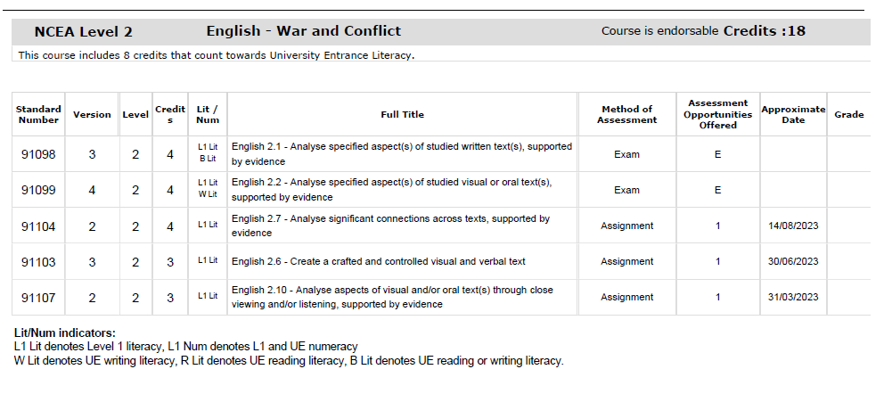
Course Summary – see Kamar portal under Reports
These are critical, so students and families can track a student’s
progress
External exam November/December
Record grades to track certificate or course endorsement progression
internal assessments during the year

Slide 16
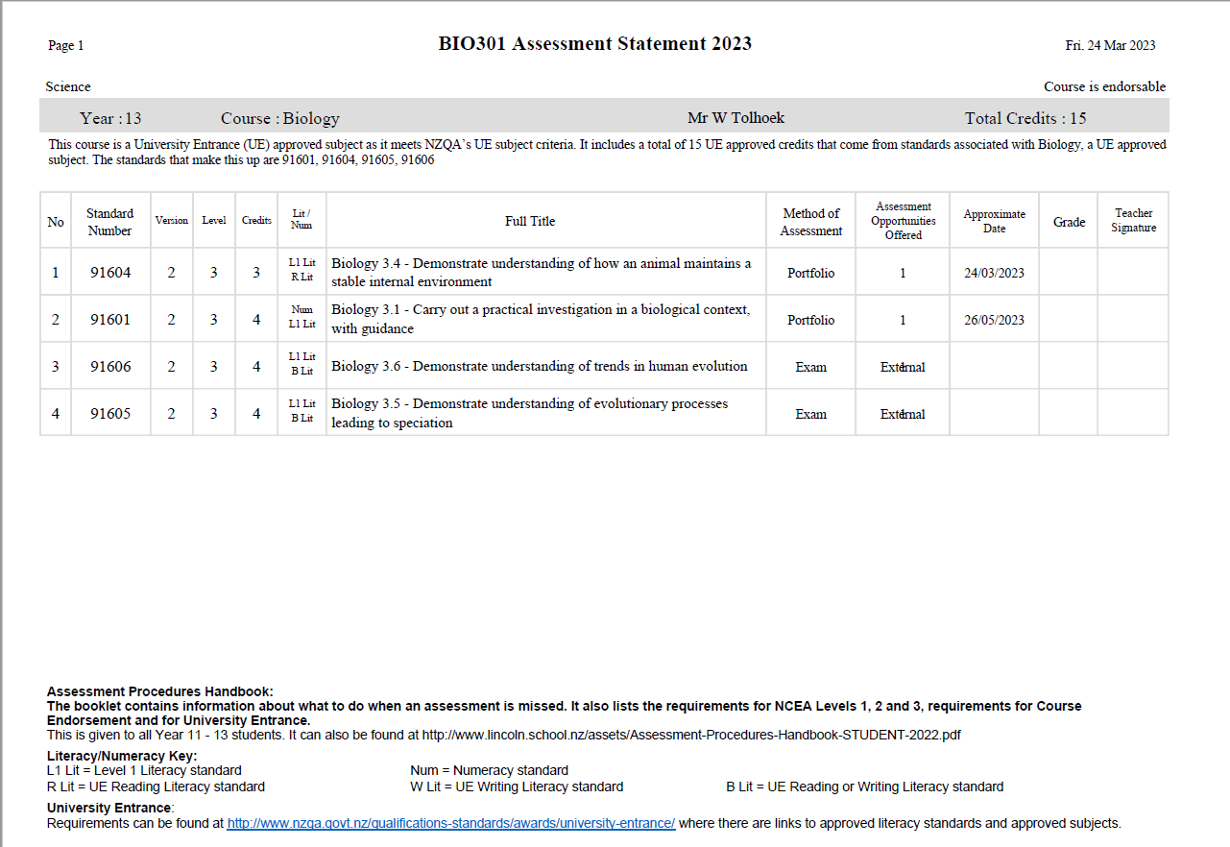
Course Summary – continued
These are critical, so students and families can track a student’s
progress
confirmed UE subject
Indicates topic counts towards UE literacy (R = reading UE credit, W = writing UE credits, B = both reading & writing UE credits).

Slide 17
Missed Assessments: Internals – during the year (refer to the Assessment Procedures Student Handbook on the school website and Kamar portal under Reports)
To get a catch-up opportunity (sit the test) or get an extension of time for an assignment students must:
Message on Teams the Tutor if they are unwell. They may be asked to gain a medical certificate, provide some brief details regarding illness, subject, teacher and assessment.
If they have a sports tournament etc message on Teams the Tutor giving dates and the assessment, teacher and subject in advance of the tournament.
They will not be eligible for an extension/resit due to family holidays.

Slide 18
External Assessments – end of year
External Assessments are usually exams sat in November. Every student in New Zealand sits these at the same time. At Lincoln High School this is for NCEA Level 2 and 3
External Examination Timetable is available on the NZQA website
https://www2.nzqa.govt.nz/ncea/exam-timetable-and-key-assessment-dates/exam-timetable/
or, Google “NCEA 2024 exam timetable”.

Slide 19
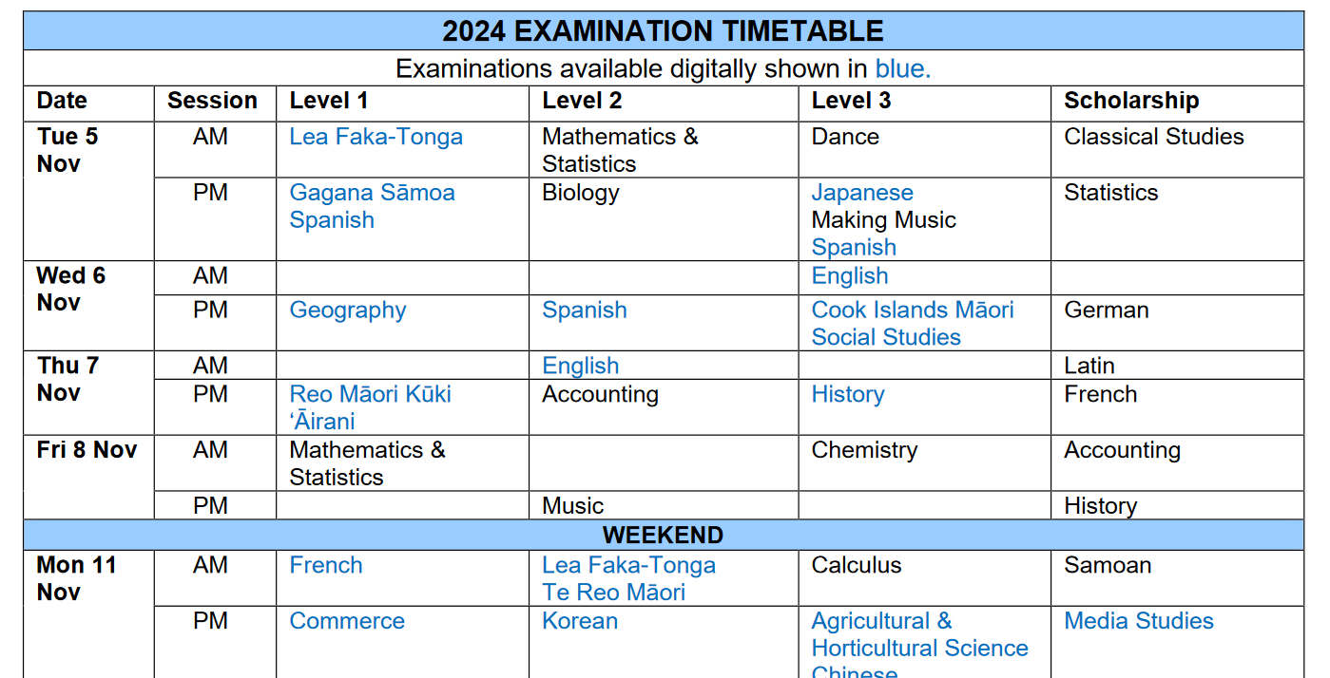
External Assessments – end of year

Slide 20
Year Level Tutors
Encourage your student to come and see their Tutor in Careers Hub regarding NCEA matters. Message them on Teams.
If you have any questions, you can email the Tutors:
Year 11 | Di Walker | dwa@lincoln.school.nz
Year 12 | Susan Johnson | sjn@lincoln.school.nz
Year 13 | Bronwyn Gardiner | bga@lincoln.school.nz

Slide 21
How you could support your student?
Monitor progress using Assessment Statements (Kamar portal in the Reports section) and record results
Access results from the Kamar portal
Access the NZQA website to access past exam papers and answers
If your student is concerned,encourage them to talk to their teacher
Encourage your student to attend tutorials and/or the Homework group on Thursdays after school
Attend parent interviews/ Linc teacher conference with student
Display and monitor study plans during exams
Encourage your student to access NCEA related tutorial websites (e.g. No Brain too Small, LearnCoach etc)

Slide 22
Further information
NZQA Information page
http://www.nzqa.govt.nz/ncea/understanding-ncea/how- ncea-works

