Slide 1
NCEA Level 2 & 3
(NCEA - National Certificate of Educational Achievement)

Slide 2
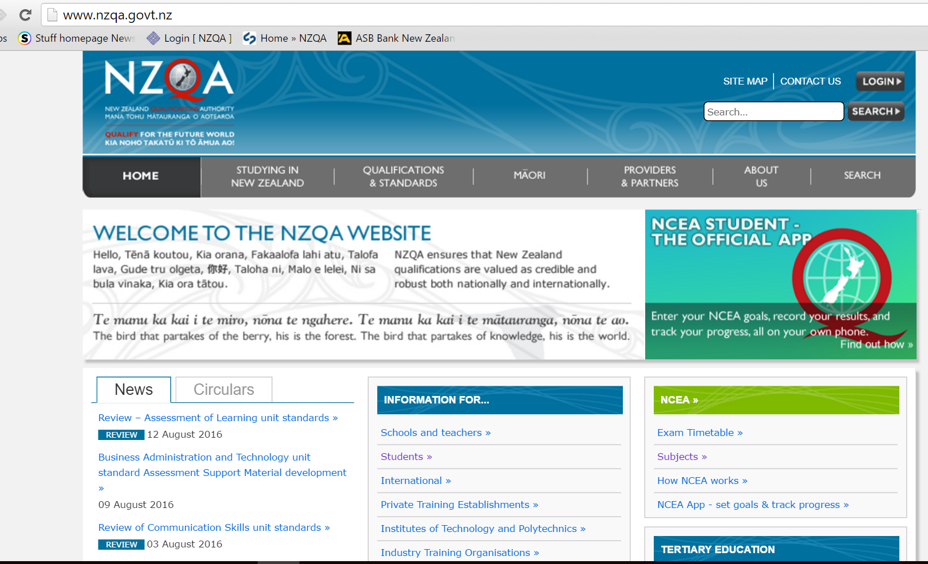
NZQA (NZ Qualifications Authority) www.nzqa.govt.nz

Slide 3
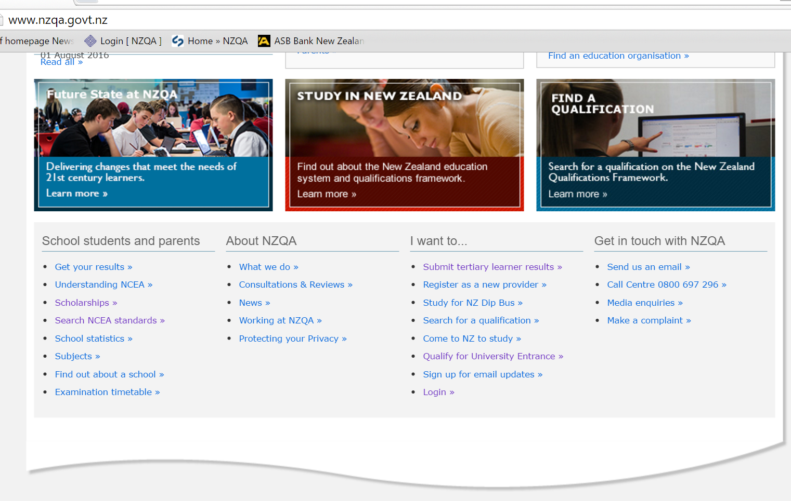
NZQA - Parent and student information

Slide 4
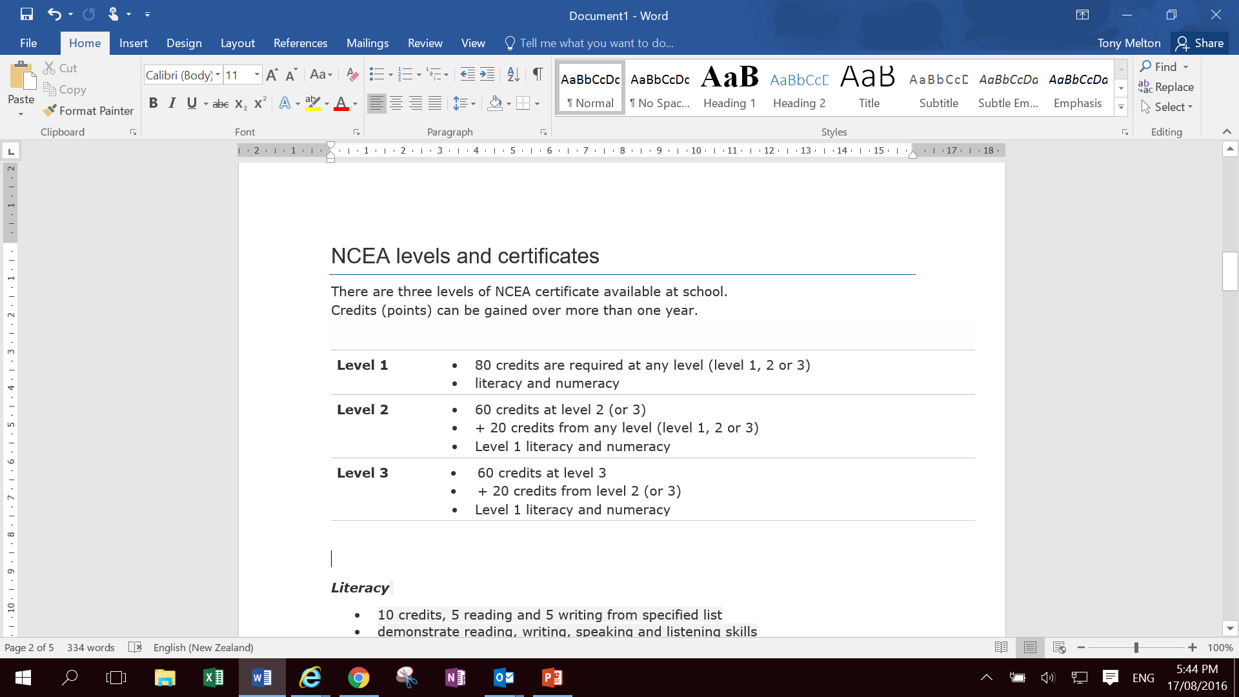
NCEA levels and certificates

Slide 5
Level 1 Literacy & Numeracy
Literacy
- 10 credits literacy from specified list
- demonstrate reading, writing, speaking and listening skills
Numeracy
- 10 credits numeracy from specified list
- demonstrate number, measurement and statistical skills.
Literacy and Numeracy credits are available in a range of courses, not just English and Maths.

Slide 6
Carry over credits
- The first 20 Level 1credits that are gained in Yr 11 are carried over to Level 2. This means students need to gain 60 Level 2 credits in Yr 12 to gain NCEA level 2.
- The first 20 Level 2 credits that are gained in Yr 12 are carried over to Level 3. This means students need to gain 60 Level 3 credits in Yr 13 to gain NCEA level 3.

Slide 7
Courses
- Yr 12 course typically offers 16 credits
Yr 13 course typically offers 18 credits
- A course is made of topics (standards) that are worth credits (typically 3-6 credits depending on the standard)
- Unit Standards (US)
possible grades = Not Achieved or Achieved
Achievement Standards (AS)
possible grades = Not Achieved, Achieved, Merit or Excellence
- A student doesn’t get more credits for a higher grade.

Slide 8
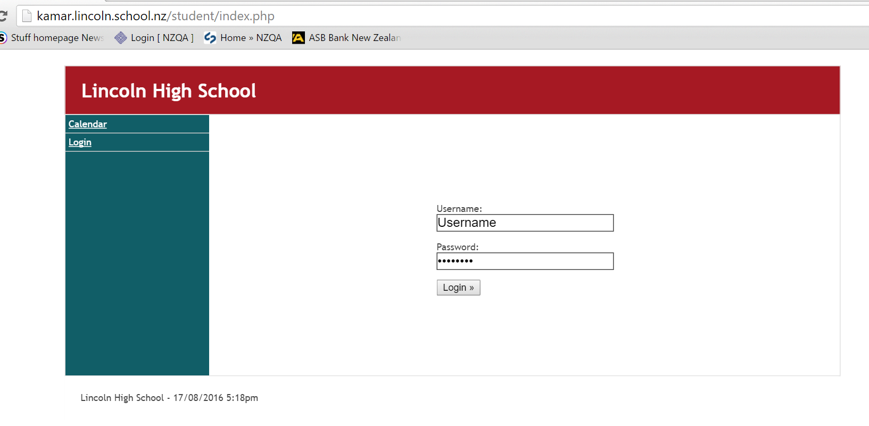
Parents & students monitor results
(Kamar portal)

Slide 9
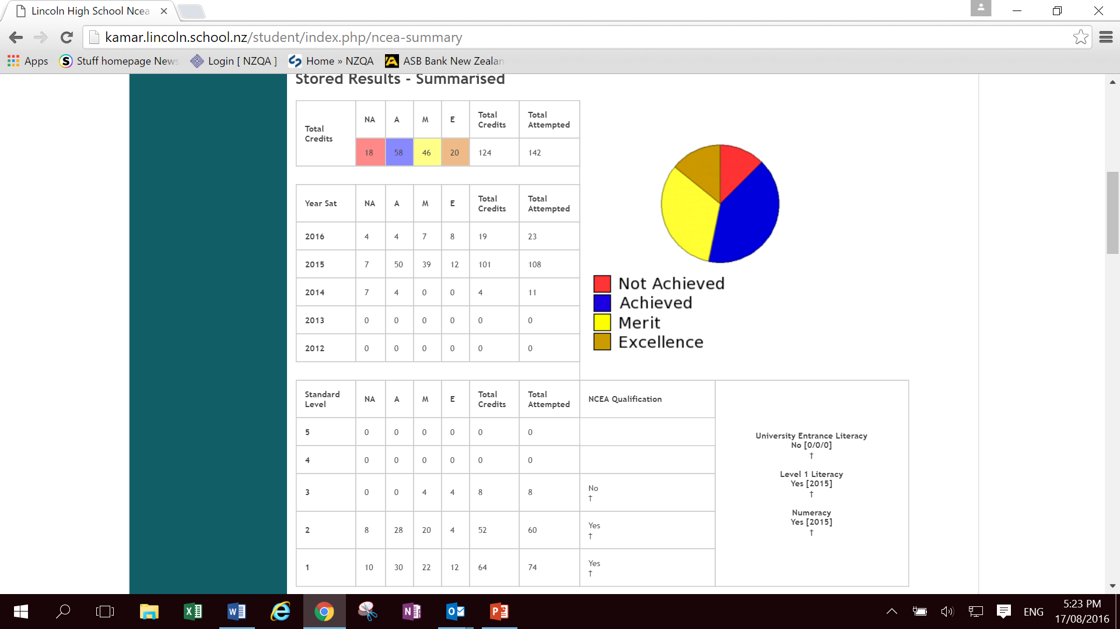
Kamar portal – NCEA results

Slide 10
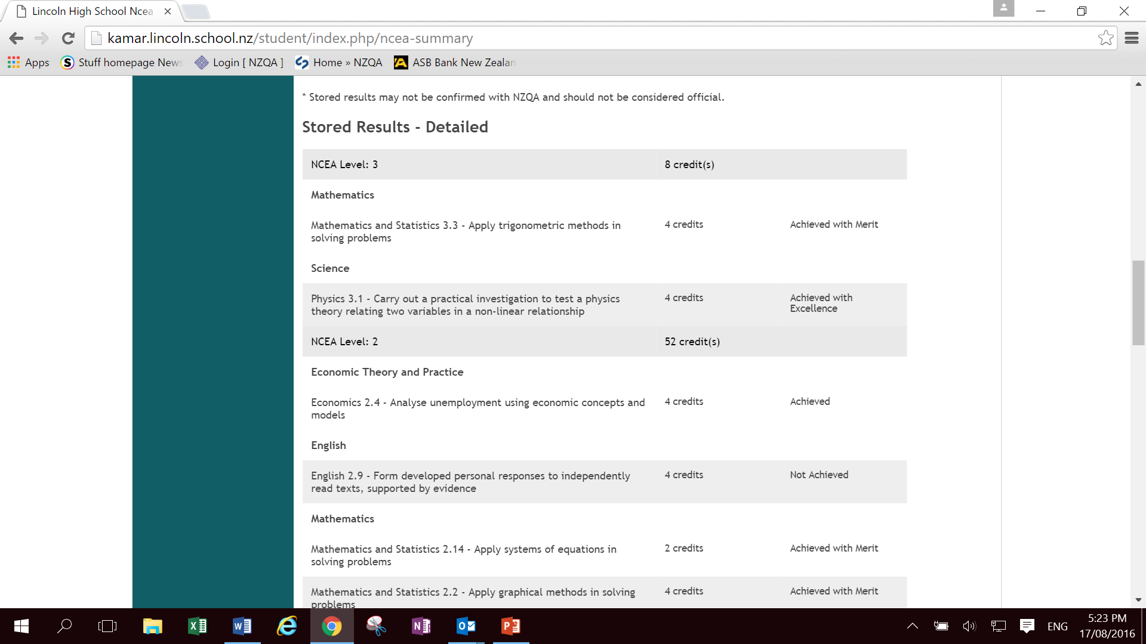
Kamar portal – NCEA results

Slide 11
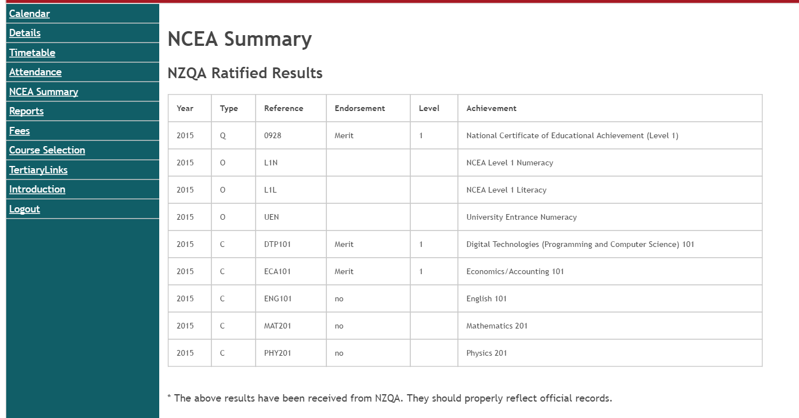
Kamar portal – NCEA results

Slide 12
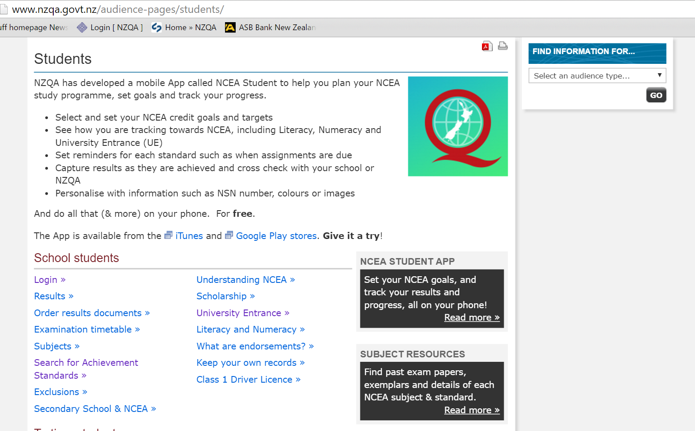
NZQA website – monitor results

Slide 13
Certificate Endorsement
For an NCEA certificate to be endorsed a student must gain 50 credits at Merit or Excellence at the level of the certificate or above.
50 Level 2 credits at Excellence = Level 2 certificate endorsed with Excellence.
50 credits at Merit (or Merit and Excellence) at Level 2 = Level 2 certificate endorsed with Merit.
Endorsement awards show on a student’s Record of Achievement that is available on the NZQA website.

Slide 14
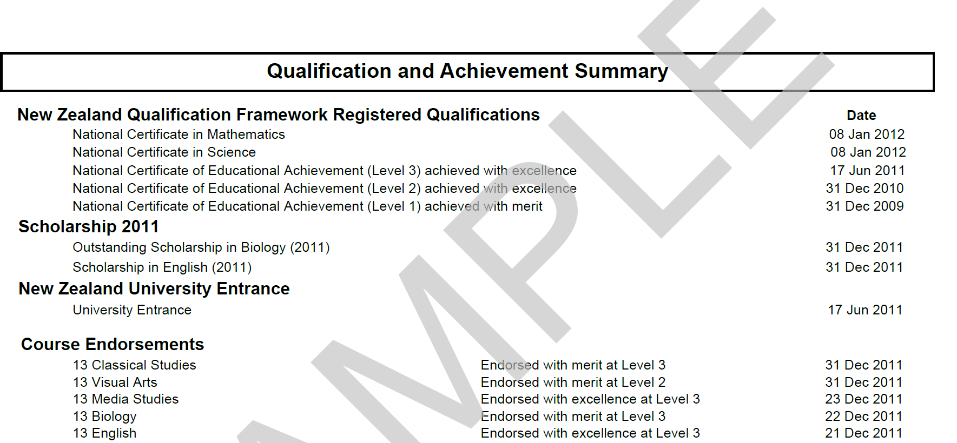
Record of Achievement

Slide 15
Course Endorsement
Course endorsement provides recognition for a student who has performed exceptionally well in an individual course eg. Mathematics endorsed with Excellence at Level 2
Students will gain an endorsement for a course if, in a single school year, they achieve:
14 or more credits at Merit or Excellence, and at least 3 of these credits from externals (exams/ folios) and 3 credits from internals (during school year assessments).
A course endorsement is not a qualification.

Slide 16
Record of Achievement

Slide 17
University Entrance
University Entrance (UE) is the minimum requirement to go to a NZ university. To qualify you will need:
1) NCEA Level 3
2) 14 credits in three different UE approved subjects - at Level 3
3) UE Literacy - 10 credits at Level 2 or above
  5 credits in reading & 5 credits in writing from the approved list
4) UE Numeracy - 10 credits at Level 1 or above,
University Entrance will appear on the Record of Achievement.

Slide 18
Record of Achievement

