Slide 1
NCEA Level 1
(NCEA - National Certificate of Educational Achievement)

Slide 2
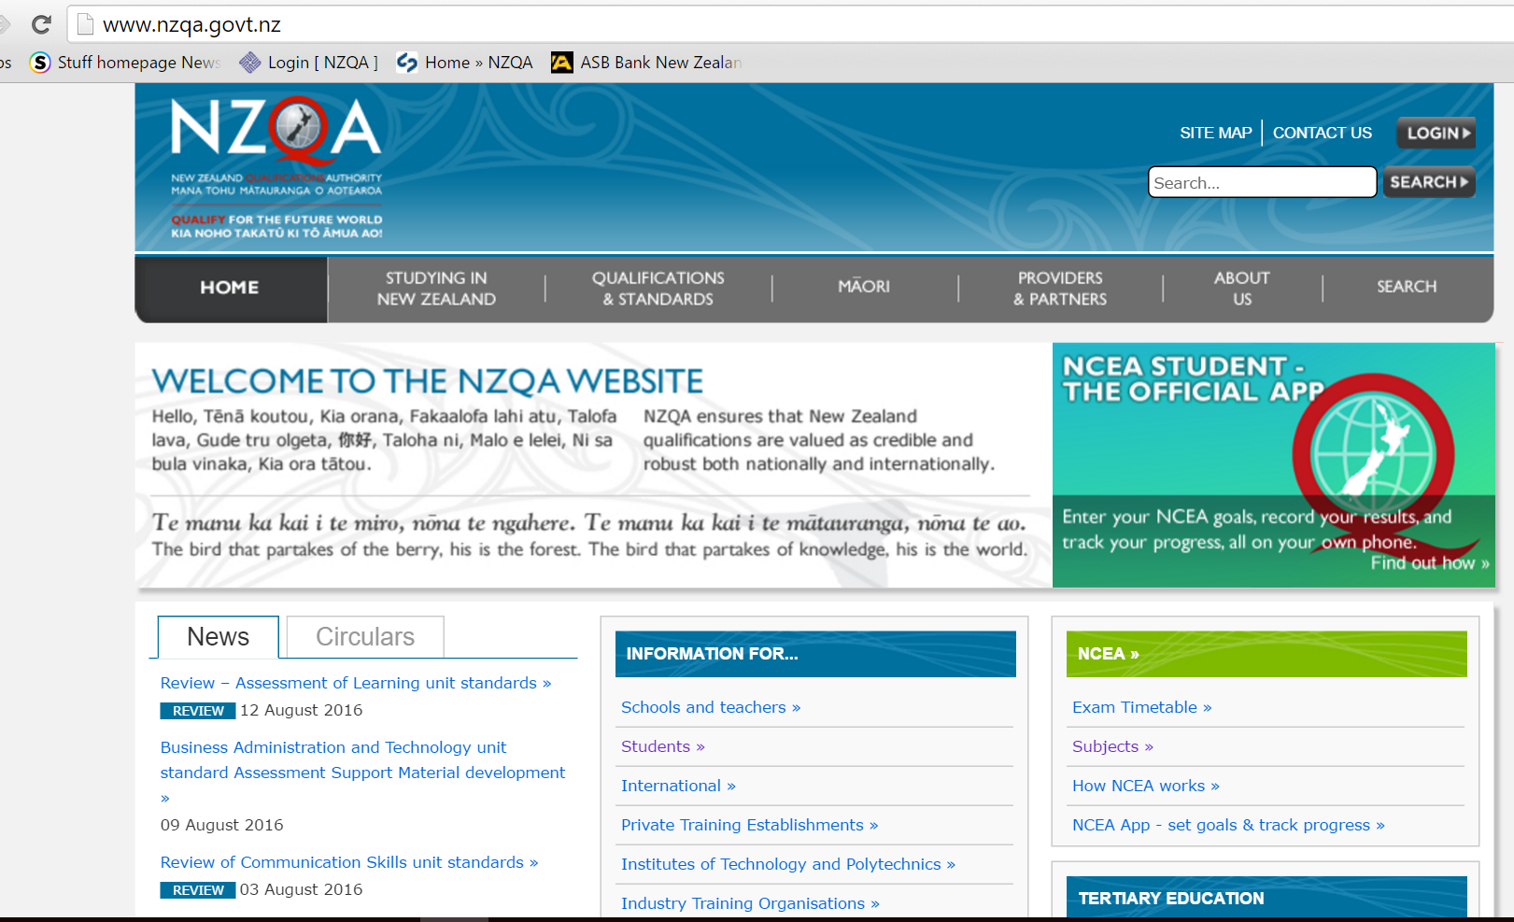
NZQA (NZ Qualifications Authority) www.nzqa.govt.nz

Slide 3
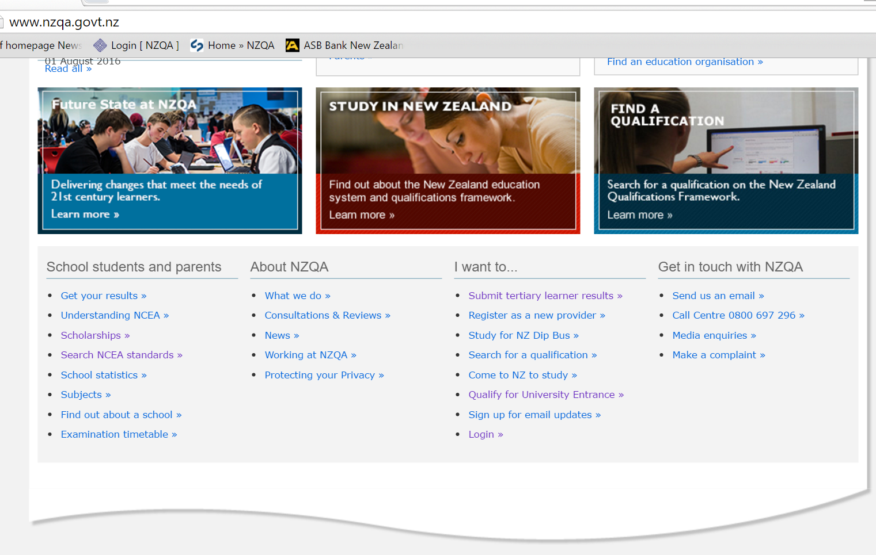
NZQA - Parent and student information

Slide 4
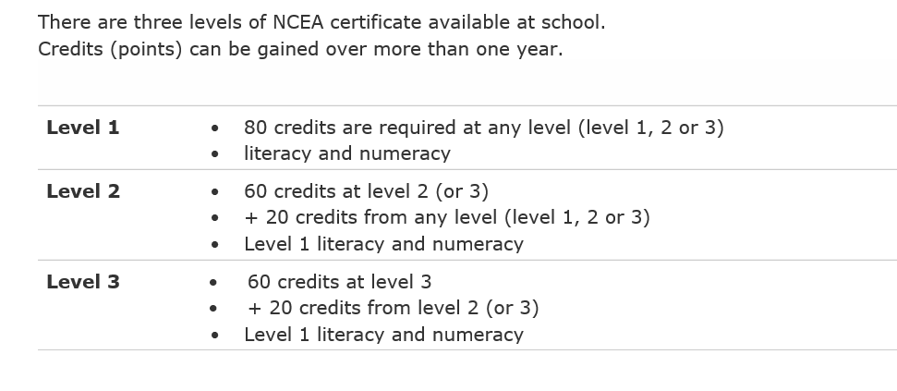
NCEA levels and certificates

Slide 5
Level 1 Literacy & Numeracy
Literacy
- 10 credits literacy from specified list
- demonstrate reading, writing, speaking and listening skills
Numeracy
- 10 credits numeracy from specified list
- demonstrate number, measurement and statistical skills.
Literacy and Numeracy credits are available in a range of courses, not just English and Maths.

Slide 6
Courses
- Yr 11 course typically offer 18 credits
- A course is made of topics (standards) that are worth credits (typically 3-6 credits depending on the standard)
- Unit Standards (US)
possible grades = Not Achieved or Achieved
Achievement Standards (AS)
possible grades = Not Achieved, Achieved, Merit or Excellence
- A student doesn’t get more credits for a higher grade.

Slide 7
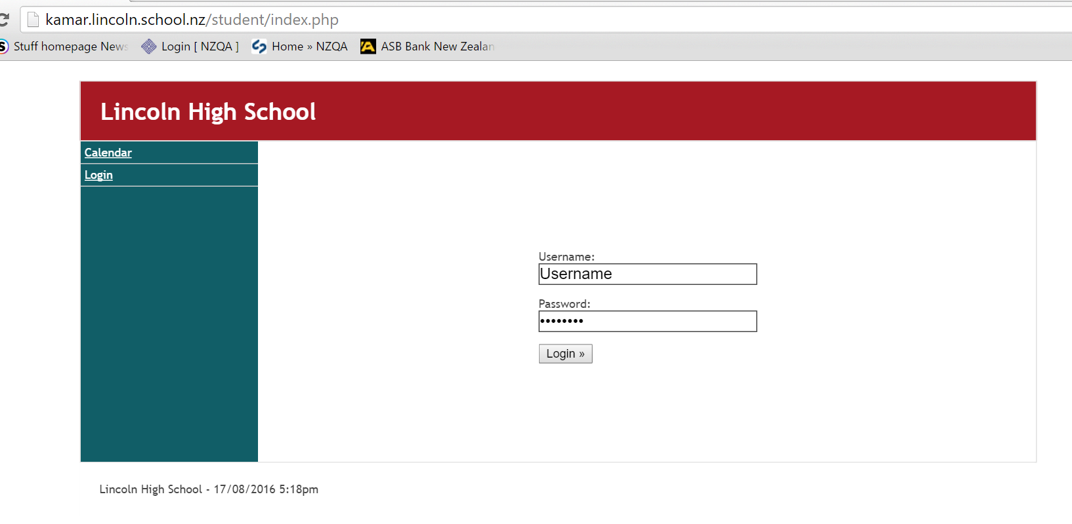
Parents & students monitor results
(Kamar portal)

Slide 8
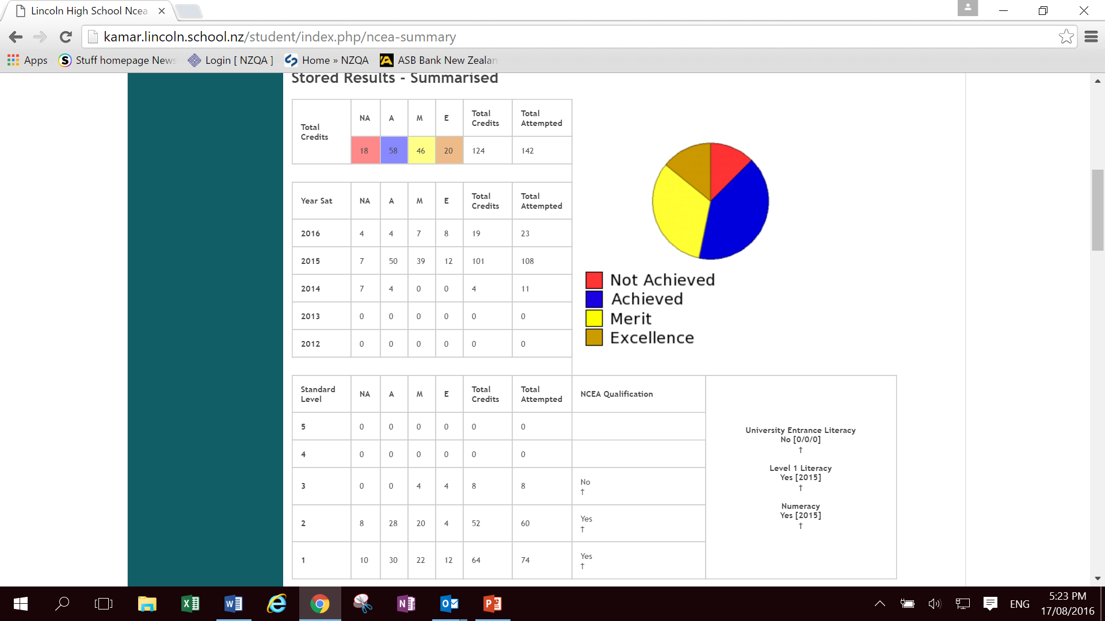
Kamar portal – NCEA results

Slide 9
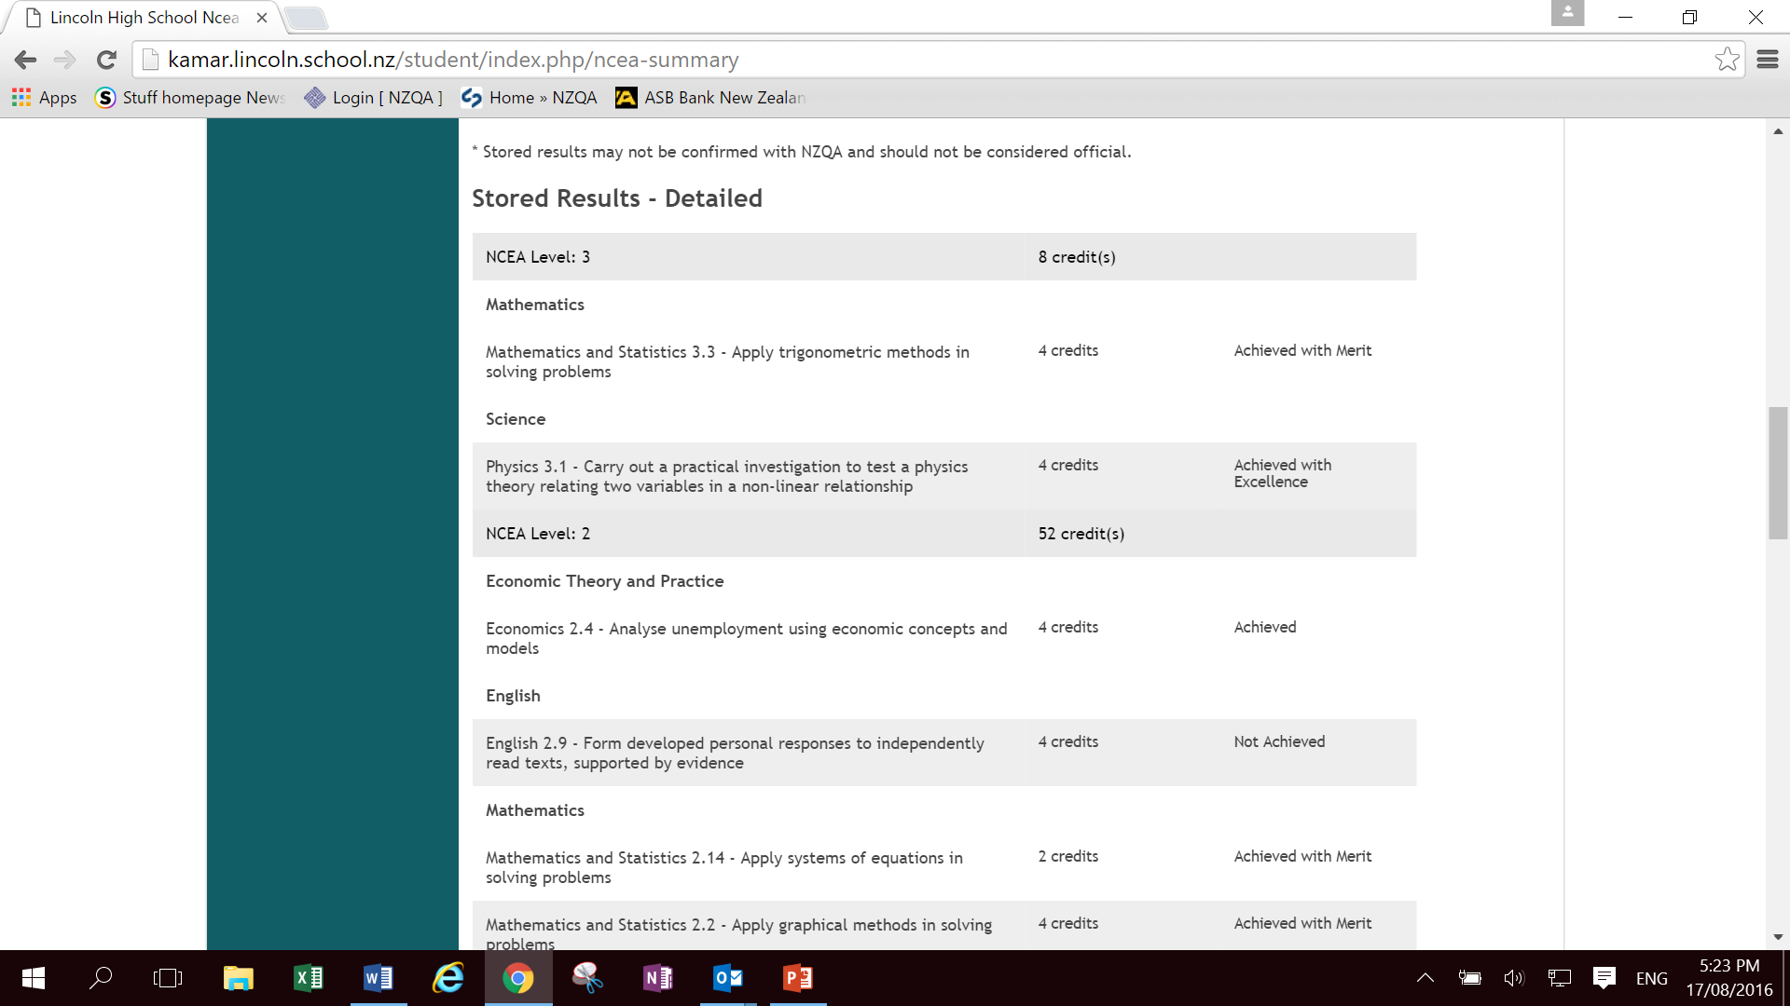
Kamar portal – NCEA results

Slide 10
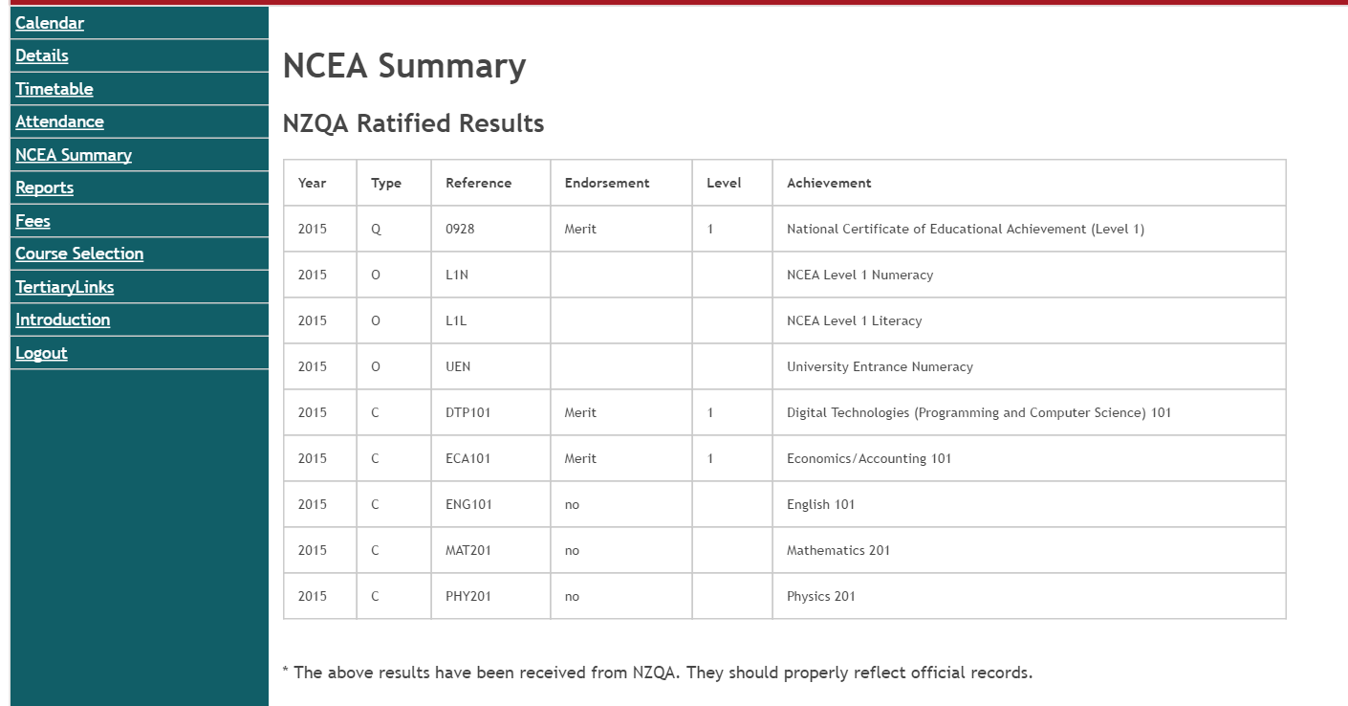
Kamar portal – NCEA results

Slide 11
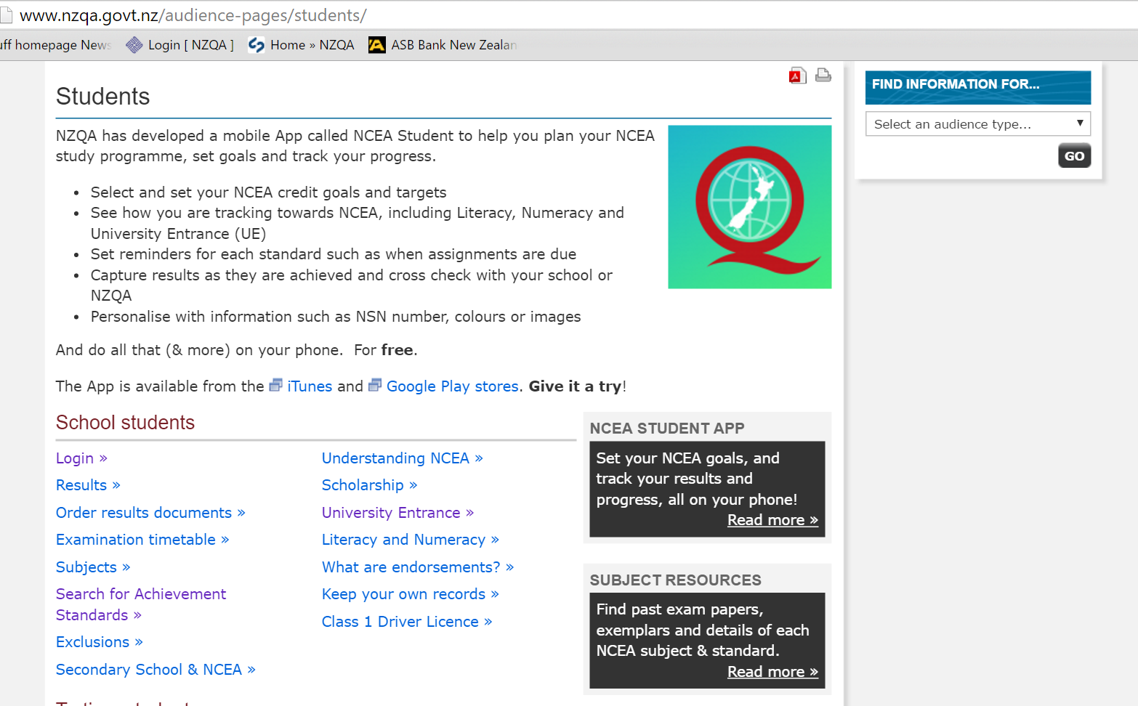
NZQA website – monitor results

Slide 12
Certificate Endorsement
For an NCEA certificate to be endorsed a student must gain 50 credits at Merit or Excellence at the level of the certificate or above.
50 Level 1 credits at Excellence = Level 1 certificate endorsed with Excellence.
50 credits at Merit (or Merit and Excellence) at Level 1 = Level 1 certificate endorsed with Merit.
Endorsement awards show on a student’s Record of Achievement that is available on the NZQA website.

Slide 13
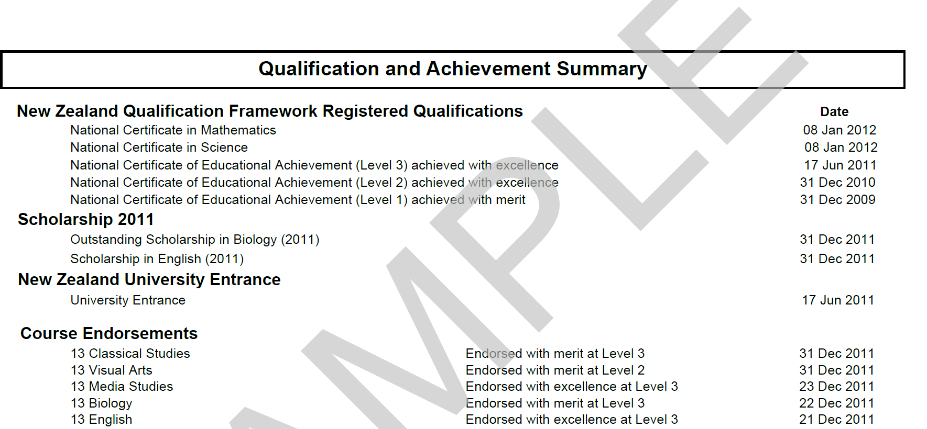
Record of Achievement

Slide 14
Course Endorsement
Course endorsement provides recognition for a student who has performed exceptionally well in an individual course eg. Mathematics endorsed with Excellence at Level 1
Students will gain an endorsement for a course if, in a single school year, they achieve:
14 or more credits at Merit or Excellence, and at least 3 of these credits from externals (exams/ folios) and 3 credits from internals (during school year assessments).
A course endorsement is not a qualification.

Slide 15
Record of Achievement

